Slide 1
SchoolNet - Logging In, Navigating and My Account

Slide 2
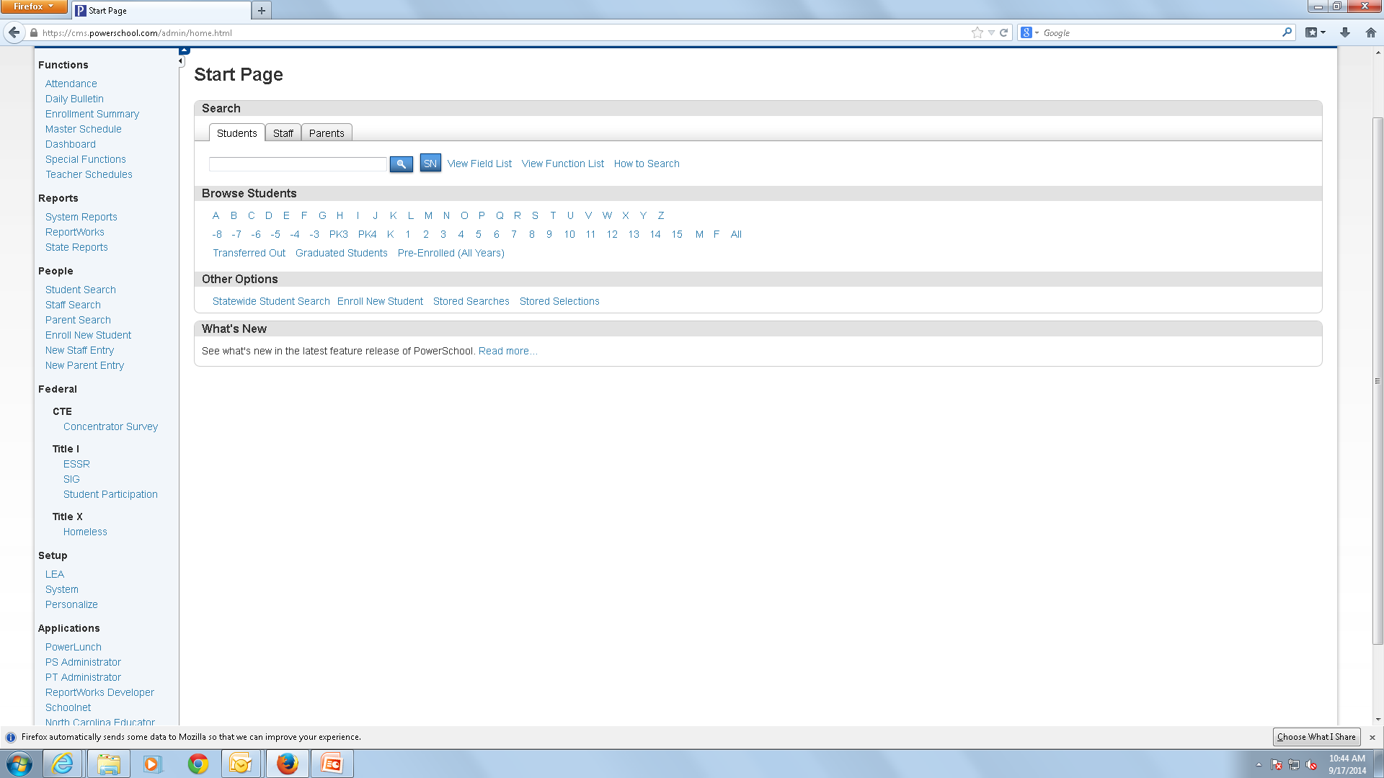
Logging into SchoolNet
Log into Powerschool ; then click SchoolNet under Applications in the left-hand column.

Slide 3
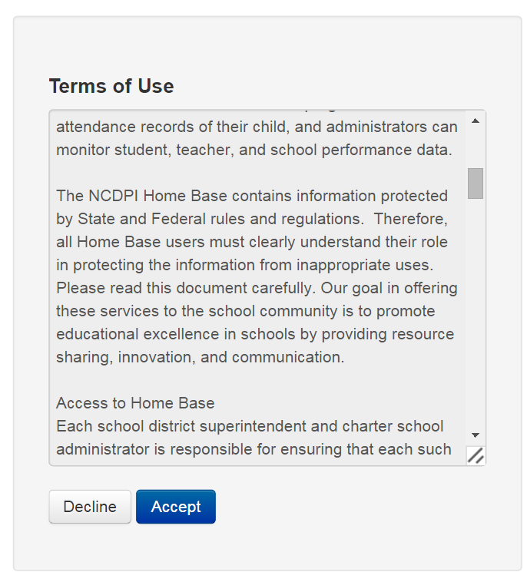
Accept Terms of Use
**Note**When logging in for the first-time, you must click Accept on the Terms of Use

Slide 4
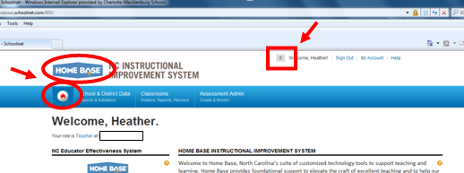
Home Page & Notification Alerts
This is your SchoolNet Home Page. Let’s familiarize ourselves with the page; first, look for the Home Base icon or for the white circle icon with the red house inside. Every time you want to return to the SchoolNet Home Page, find either one of those and click to return home. Also notice, the notification icon, on the top of the start page, notification alerts appear here; simply click the icon to view the notifications.

Slide 5
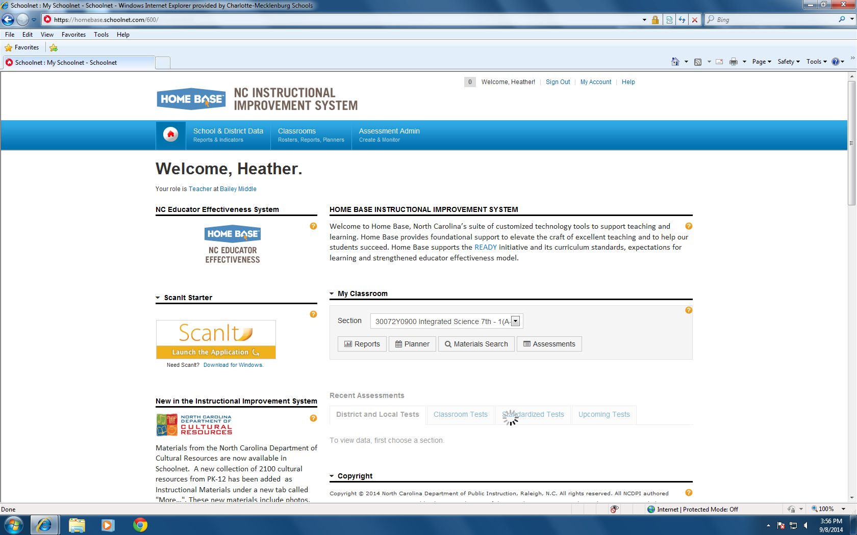
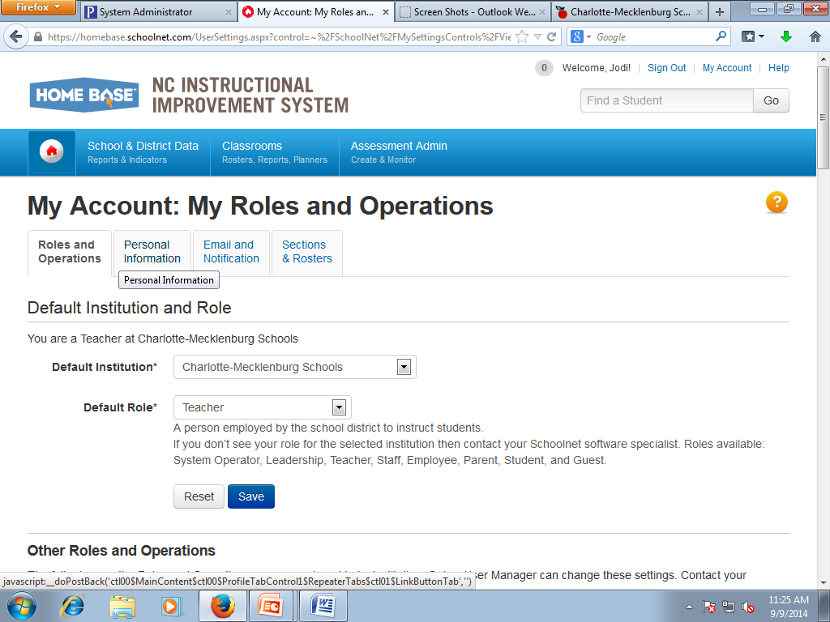
My Roles and Operations
Make sure to verify your name and default Role and Institution; displayed under the Welcome, “your name” area on the start page. You can also verify this information in the My Roles and Operations screen by clicking My Account and looking under the Roles and Operations tab.

Slide 6
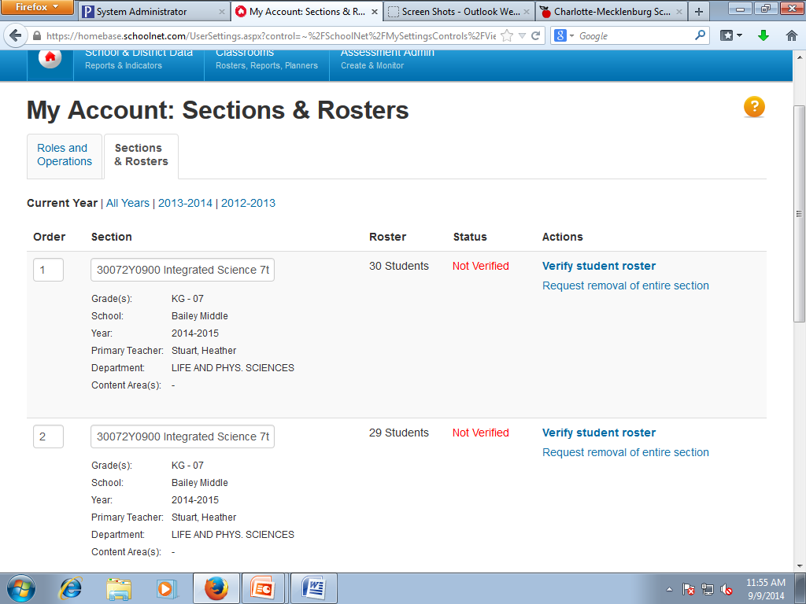
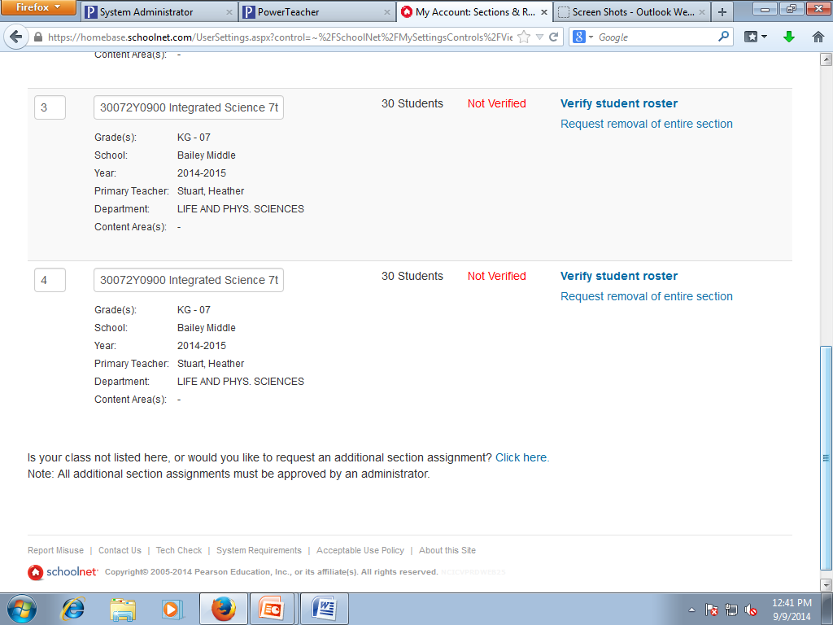
Sections & Rosters
Now click on the Sections & Rosters tab. In this area, you verify your student roster, request the removal of a section or request an additional section assignment.

Slide 7
Logging In, Navigating & My Account Conclusion
This concludes the SchoolNet - Logging In, Navigating and My Account Overview

Slide 8
SchoolNet – Web Parts Overview

Slide 9
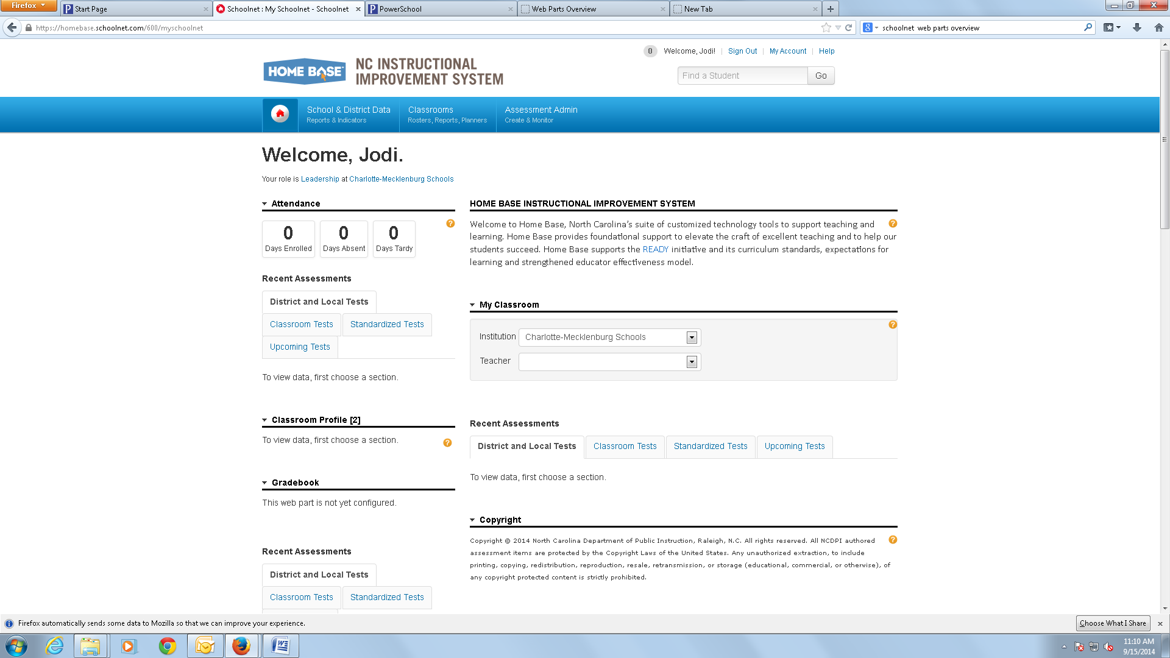
What Are Web Parts
Looking at your SchoolNet Home Page you will notice sections; these sections are considered web parts. If your role is “Leadership” you will be able to add or remove these sections to customize the home page. As a “Teacher”, you will have access and the ability to use each section on the default home page already created for you.

Slide 10
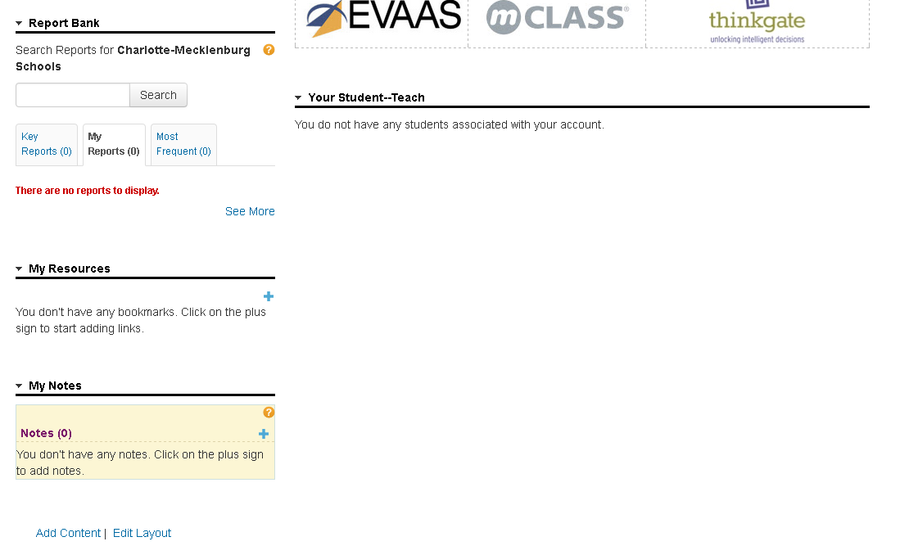
Changing the Layout
In a “Leadership” roll, scroll down to the bottom of the start page and you will notice the “Add Content” and “Edit Layout” hyper links. Click “Add Content”

Slide 11
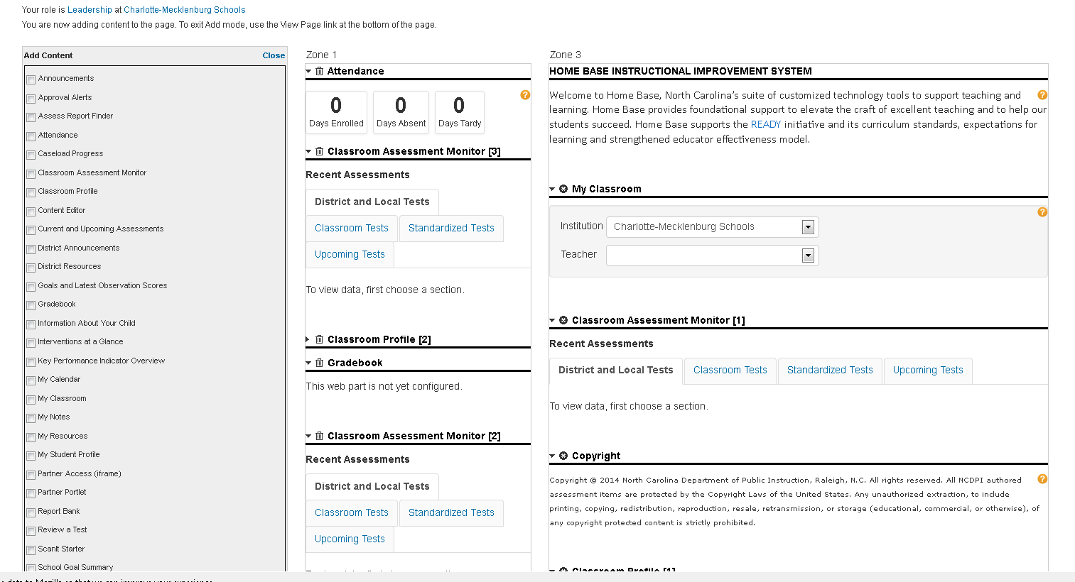
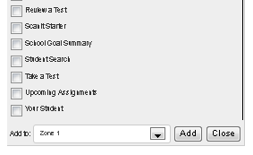
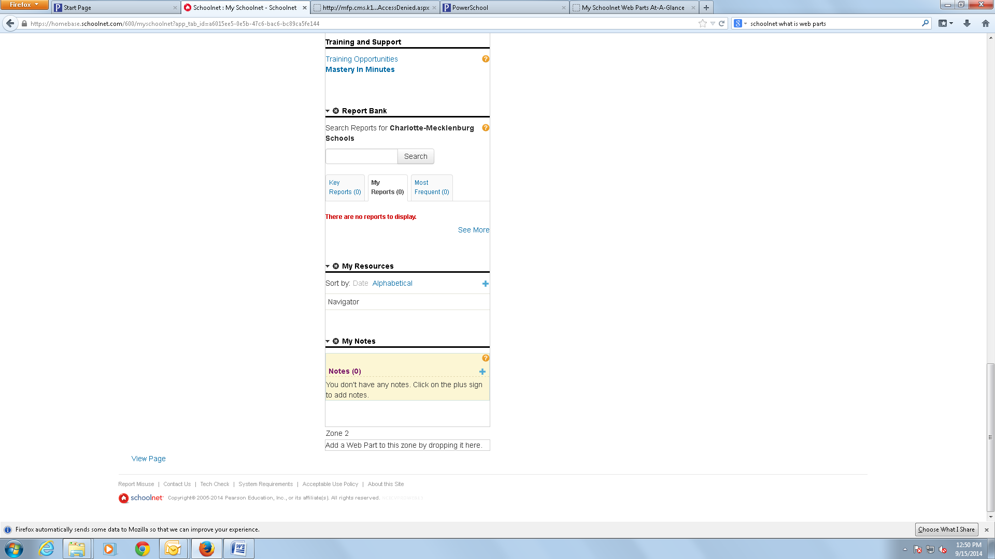
Adding Web Parts
After clicking on “Add Content” you will see this screen. On the left side, you will have a list of choices of web parts to add to your home page. Check the ones you want to include on the home page and then scroll to the bottom and use the drop down to choose the Zone you want your choices to be placed in. Note – Zone 1 is the top left section, Zone 2 is the bottom left section and Zone 3 is the right side. After choosing the zone click “Add” and then “Close”.

Slide 12
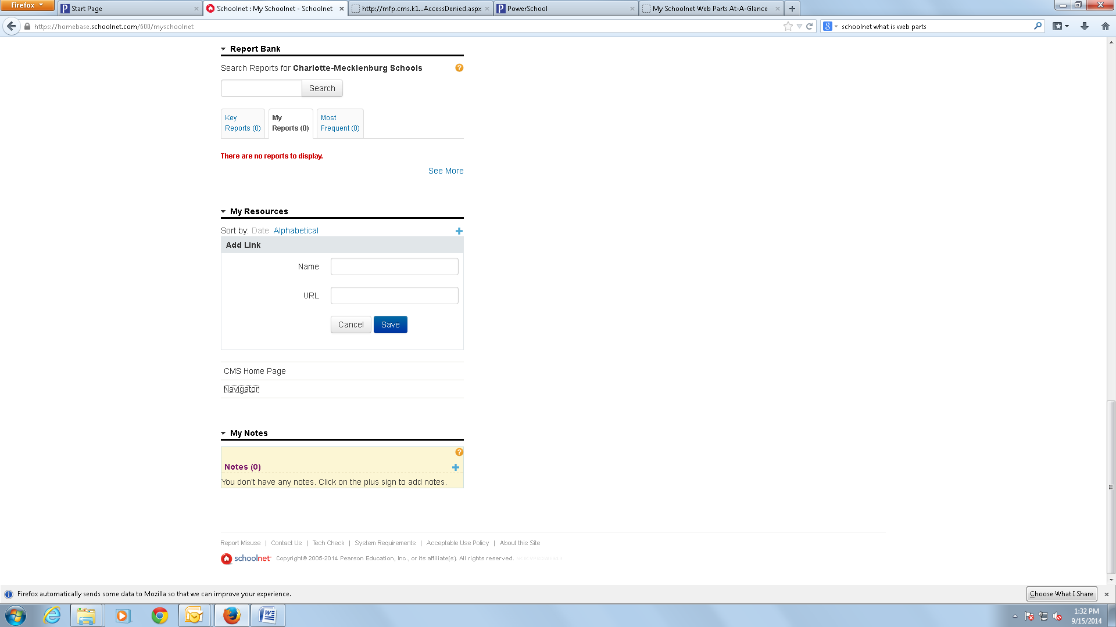
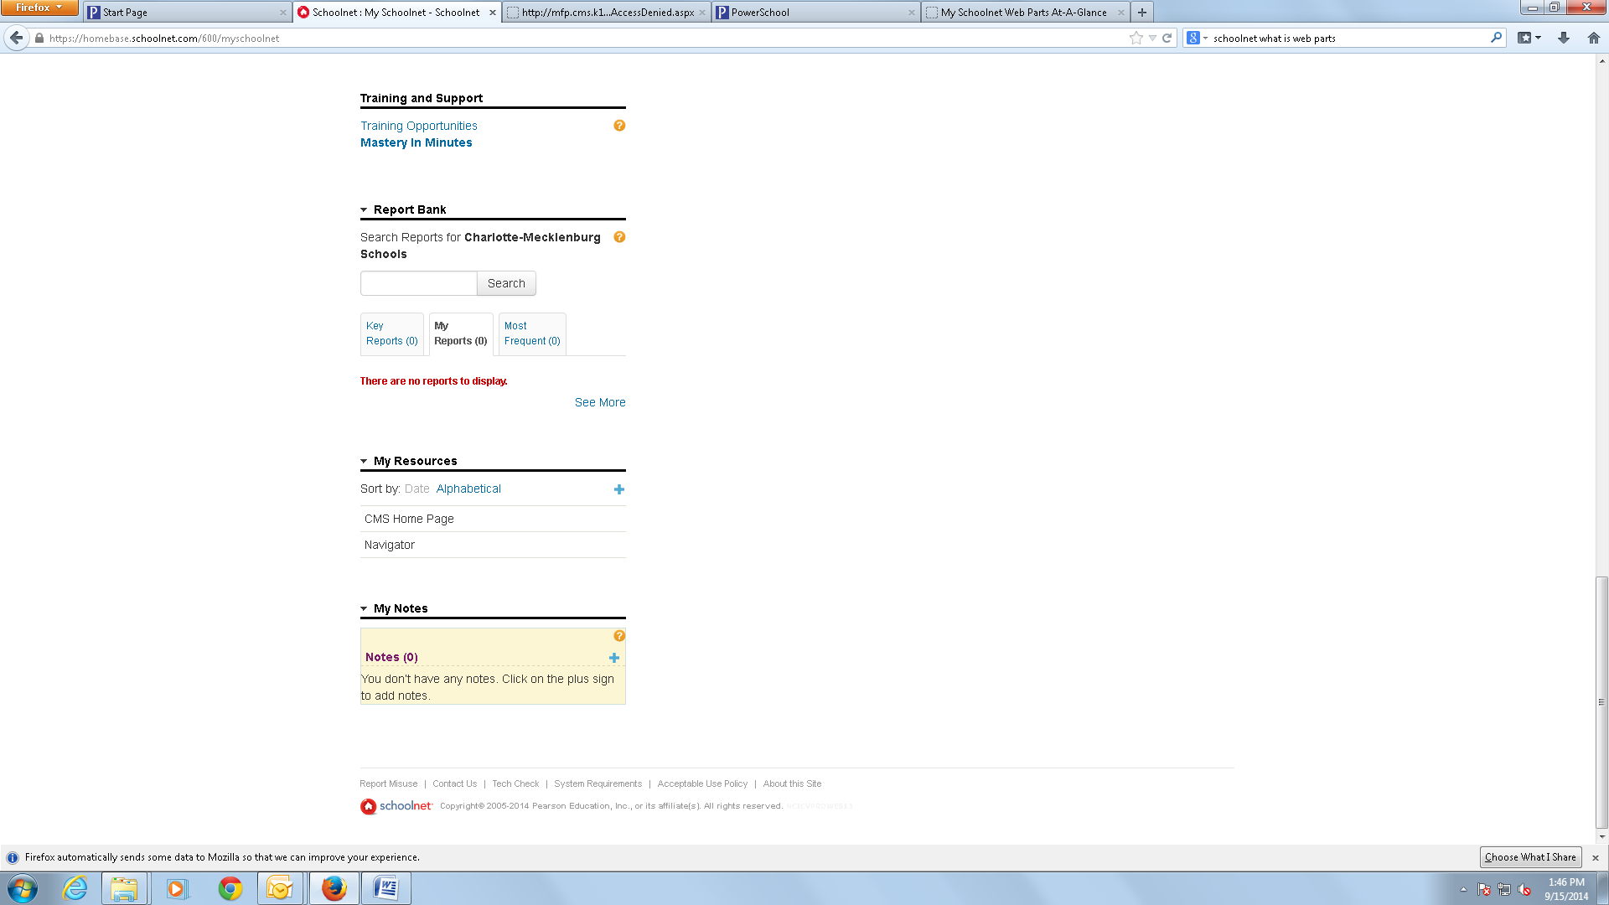
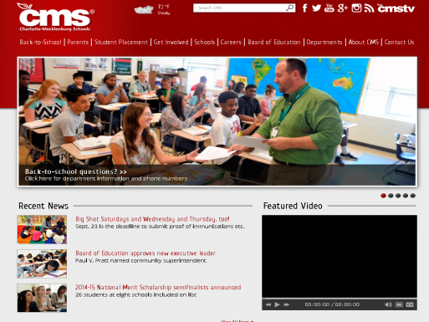
Report Bank
As a “Teacher”, you will not have the ability to add or remove sections but you are able to use each section. As an example, please scroll down until you see “My Resources”. In the “My Resources” section, click the “+ “ sign. A drop box will appear; in the “Name” box type in My CMS Home Page. In the “URL” box type in http://www.cms.k12.nc.us. Click “Save”.
When you return to the home page you will see “CMS Home Page” link under the “My Resources” section. If you click that link it will take you immediately to the CMS webpage.

Slide 13
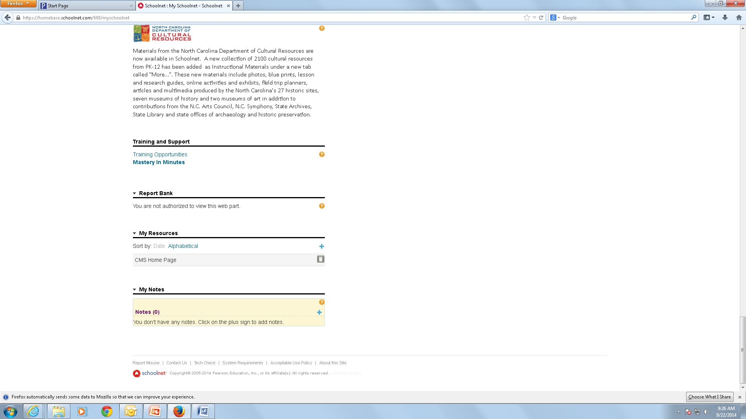
Removing Links
To remove a link, place your cursor on the left side of the box the link is in and a trash can will appear. Click the trash can and your link will be deleted.

Slide 14
Edit Layout
If you are in a “Leadership” roll you can also edit the layout of the home page. Click “Edit Layout” at bottom of your home page.

Slide 15
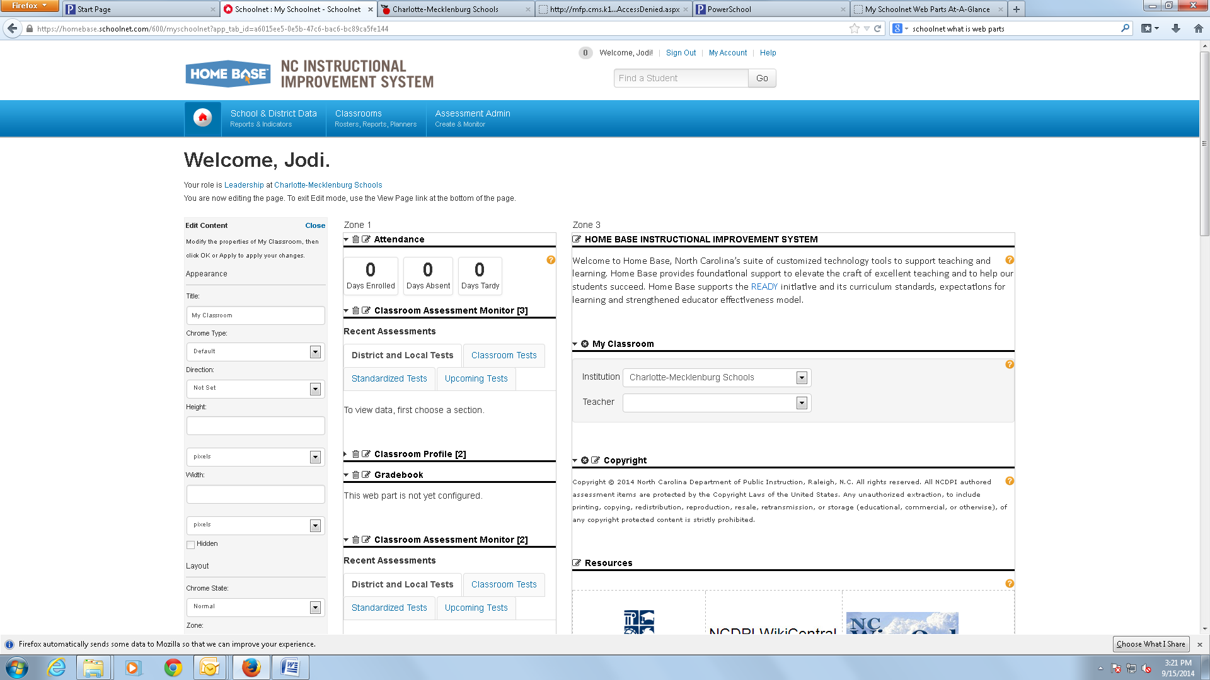
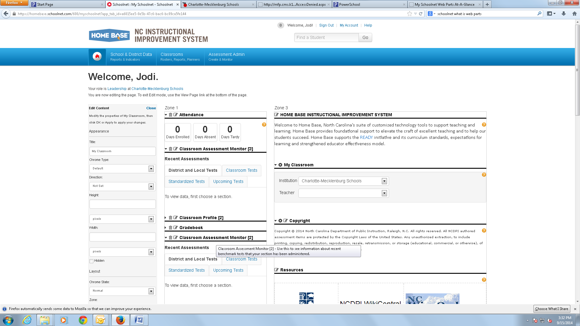
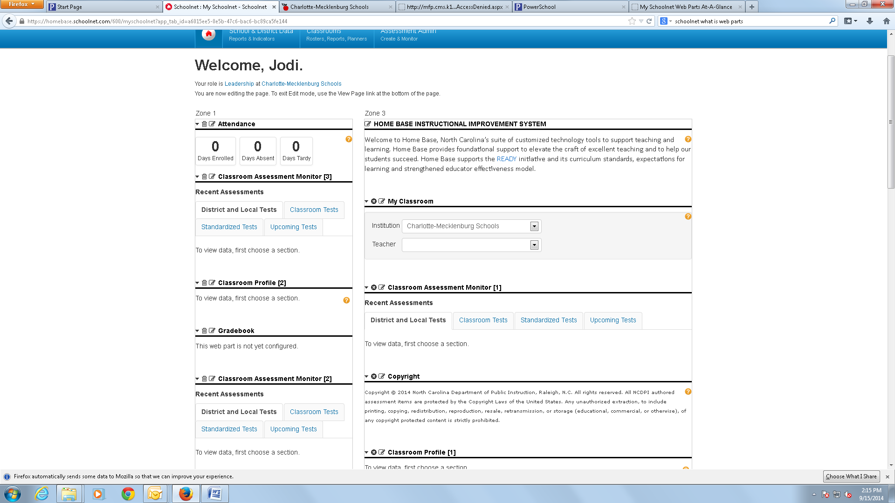


Icons Used for Editing
Your “Edit Layout” page will look like this. Aside of each web part you will see icons that perform certain functions. When you click on one of these triangle shaped icons, pointing down or to the side it will either minimize the web part or expand it to see detailed information. Clicking this icon will delete the web part from your view on the home page. This is your edit button. And clicking this will close that web part.

Slide 16
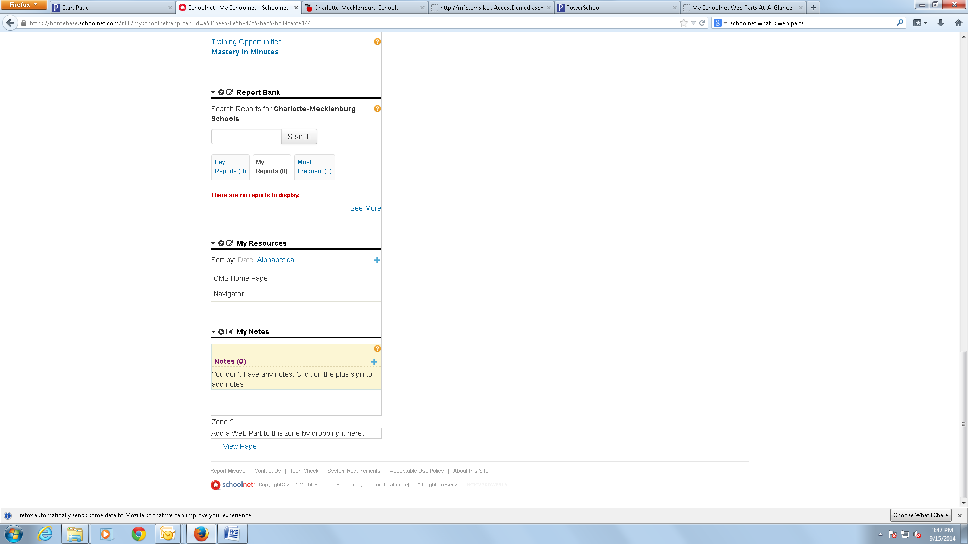
View Page
Now scroll all the way to the bottom of the page and click on the “View Page” link and you will be returned to your Home Page.

Slide 17
Web Parts Conclusion
I hope you enjoyed the Web Parts Overview.

Slide 18
SchoolNet - Classroom

Slide 19
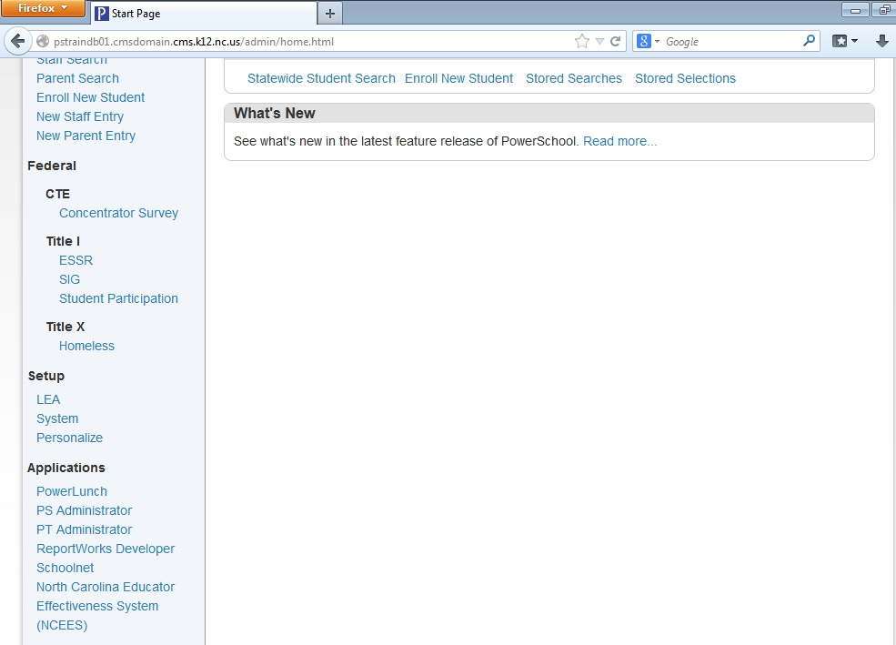
Logging into SchoolNet
Log into Powerschool. Click SchoolNet under Applications on left-hand column

Slide 20
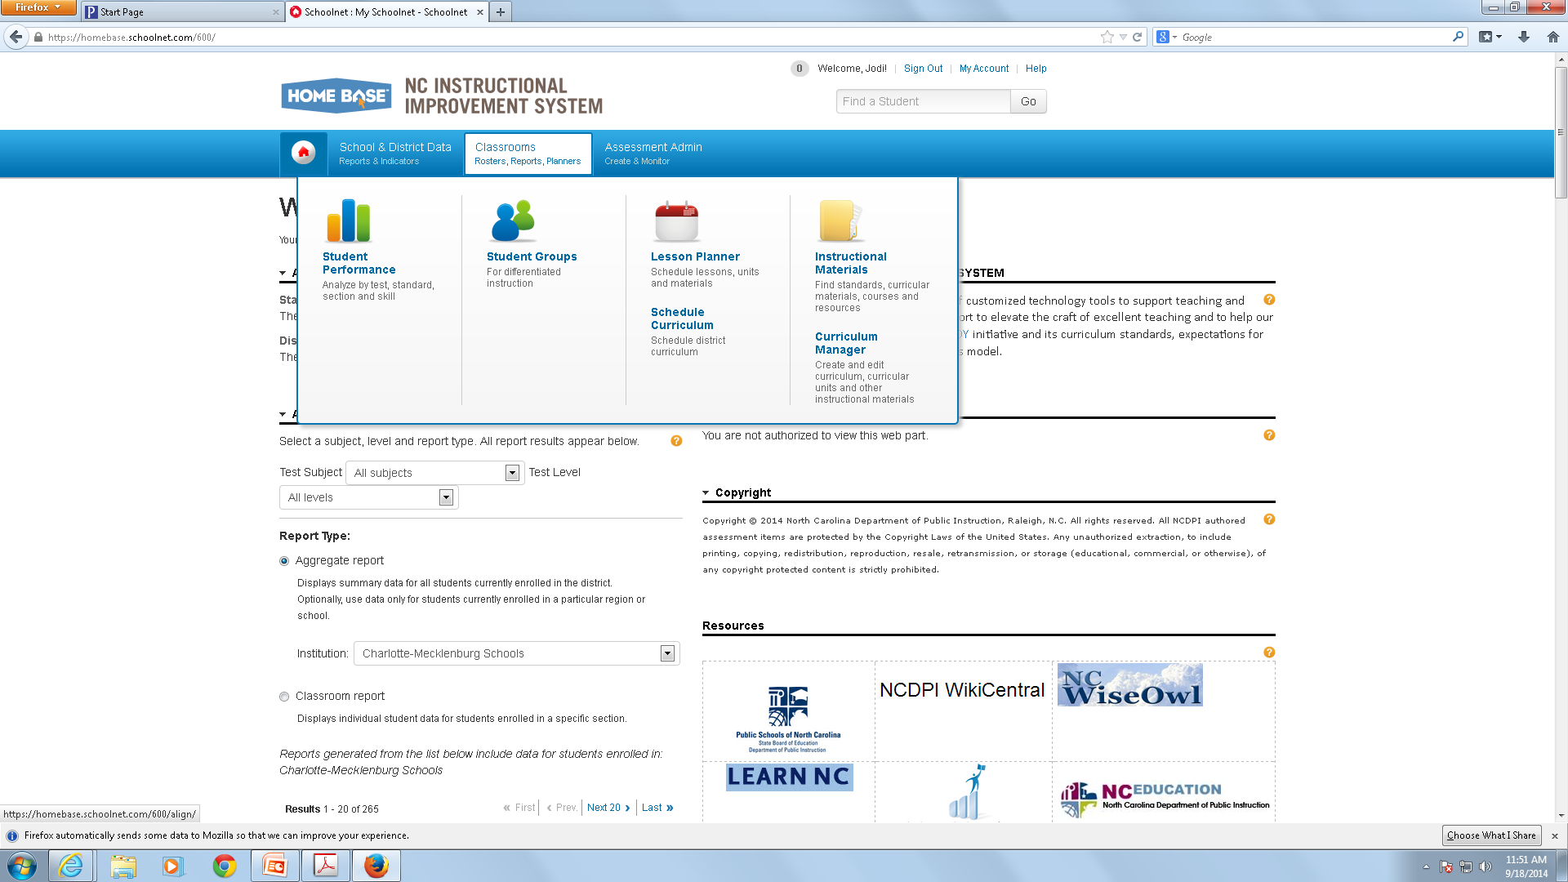
Classrooms
From the SchoolNet Home Page, place your cursor over Classrooms and then click on “Student Performance”

Slide 21
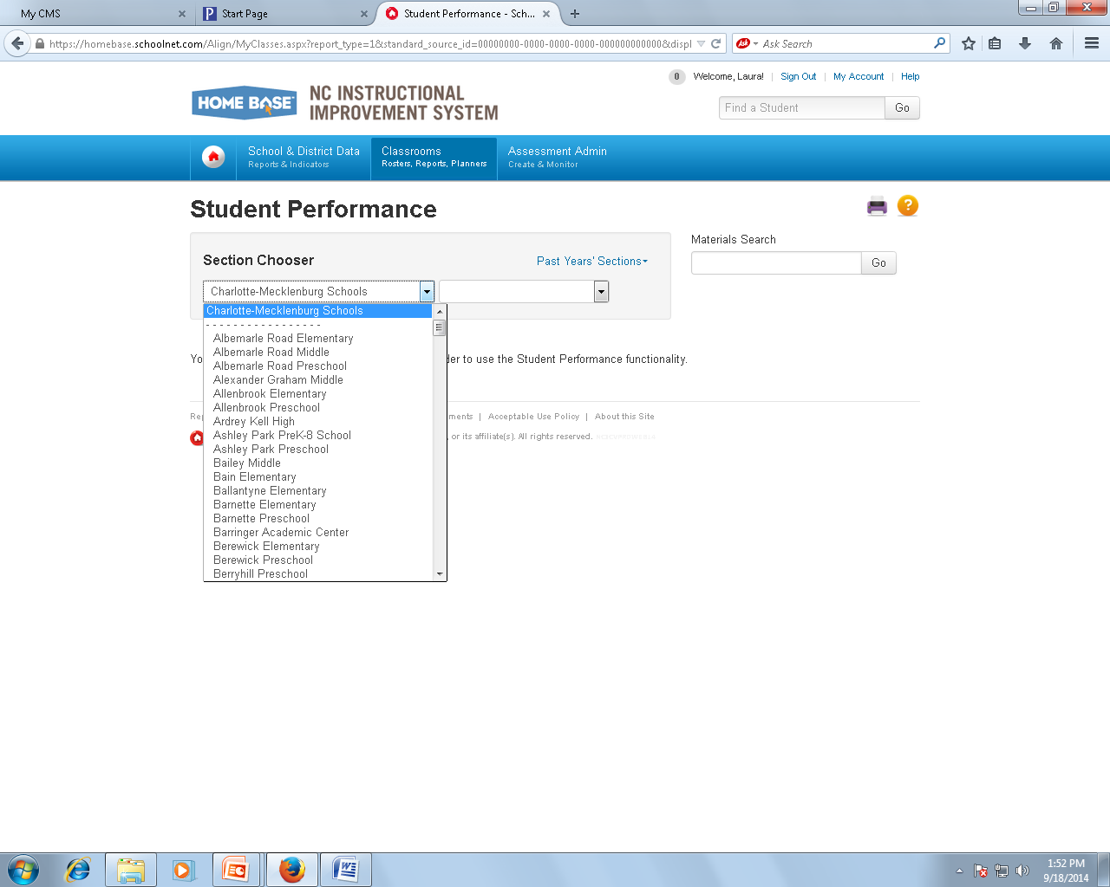
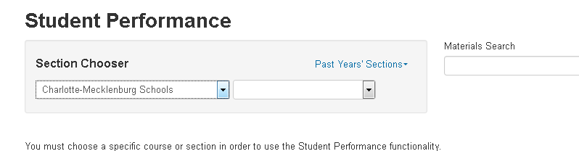
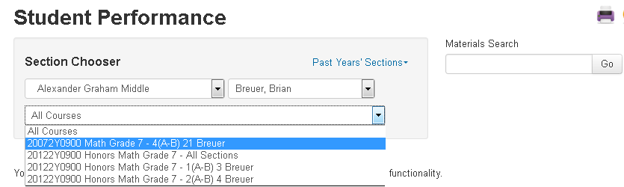
Student Performance
The Student Performance section offers the ability to drill down to the student level and create custom reports related to that student. For administrators, you must first select a school and teacher from the Selection Chooser menu. (This information will default for teachers).

Slide 22
Student Performance Tabs

Slide 23
Student Performance Guide
Classroom Test Dashboard | Allows you to view data related to Classroom tests (i.e., tests created and administered by a teacher to their own students or sections and administration-assigned or –recommended tests for which data is not aggregated at the district level)
Item Analysis | For any benchmark, classroom or standardized test, see the selected answer each student and the standard that it is aligned to the question. This tab is hidden if your district does not have benchmark reporting
Skill Analysis | View student performance on each standard assessed during the year
Standards Mastery | View specific course standards to see how many times they have been addressed (or scheduled), and student’s collective mastery on recent assessments or course standards as measured by those assessments
Summary Statistics | Provides information regarding District and State benchmark test scores
Student List | View the students enrolled in each of your classes. Each student has an individual Student Profile which you can use to track a student’s academic progress, special needs, etc

Slide 24
Student Groups
From the Home Page, put your cursor over Classrooms again and then click “Student Groups” from the drop down.

Slide 25
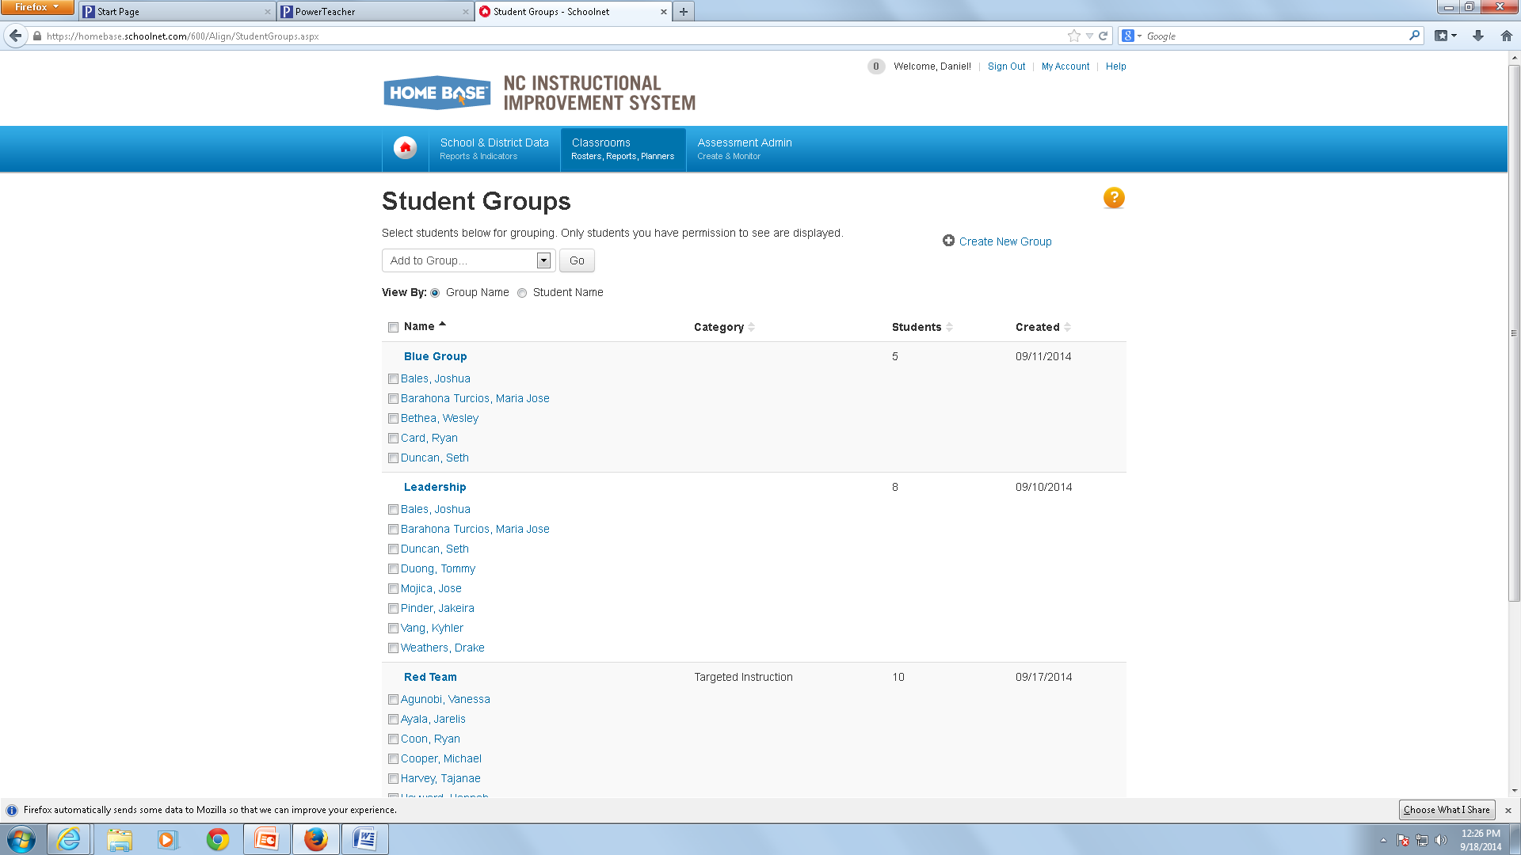
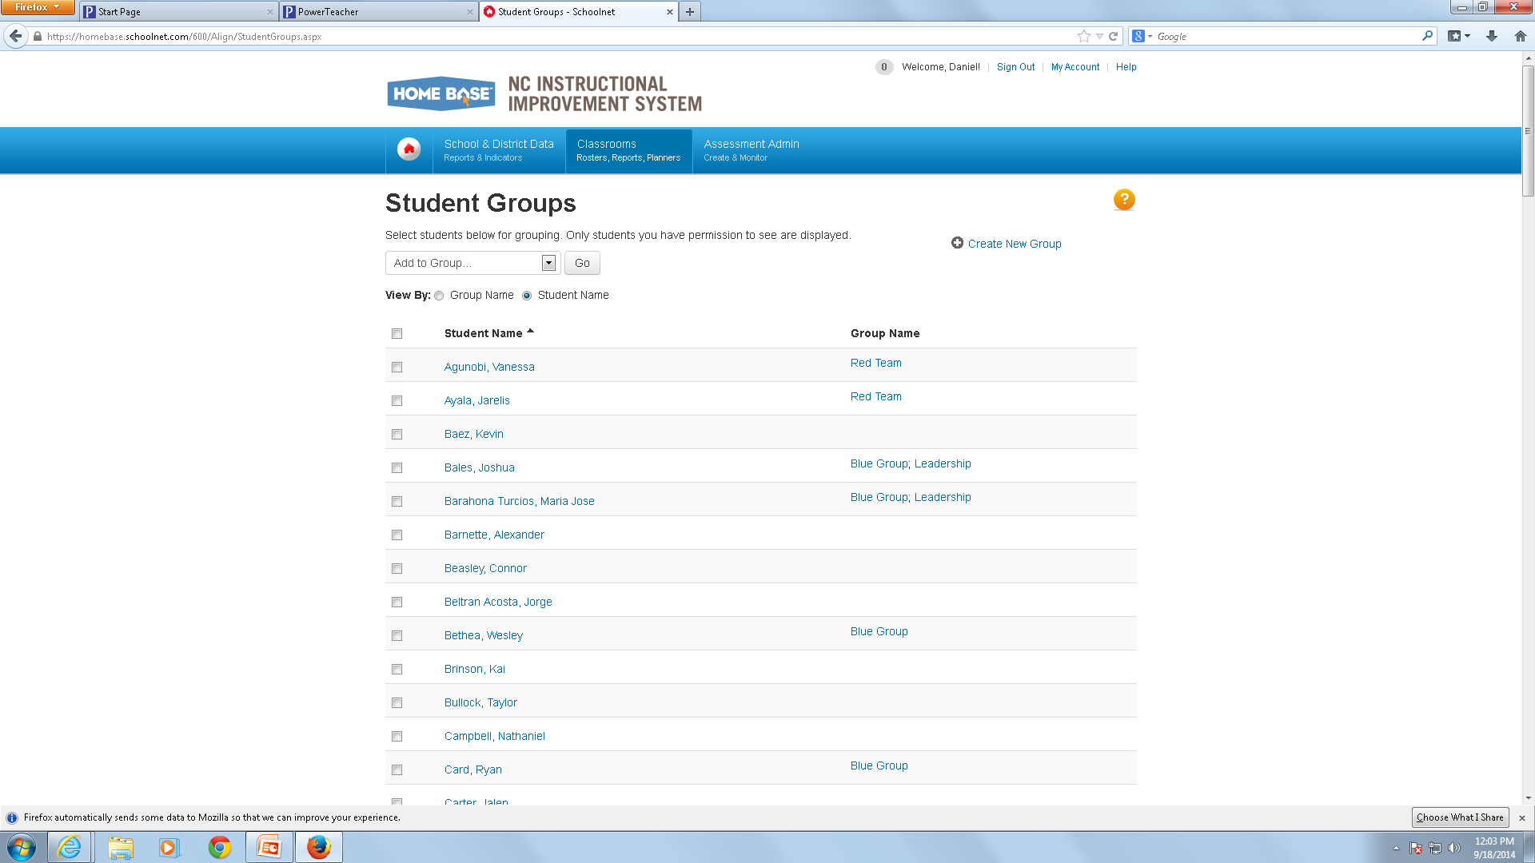
Student Groups
After selecting “Student Groups” it may be necessary, if your screen does not default to list all students to change the setting by “View By” to “Student Name”

Slide 26
Creating Student Groups
Once all your students appear, select “New Group” from the drop down menu and then select the students you want in that group and then click “Go” In the next window , assign a group name and category (optional), then select “Save”.

Slide 27
Edit Student Groups

Slide 28
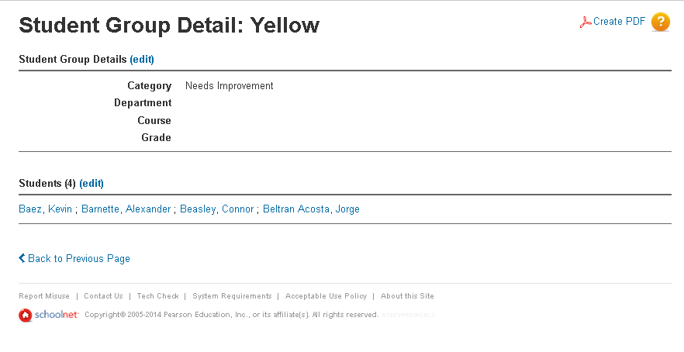
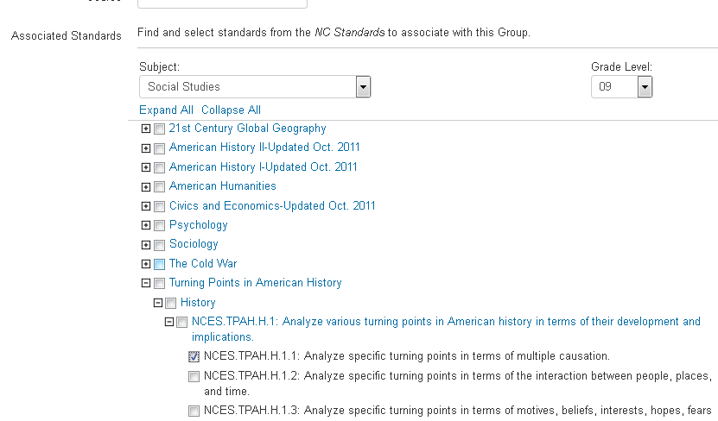
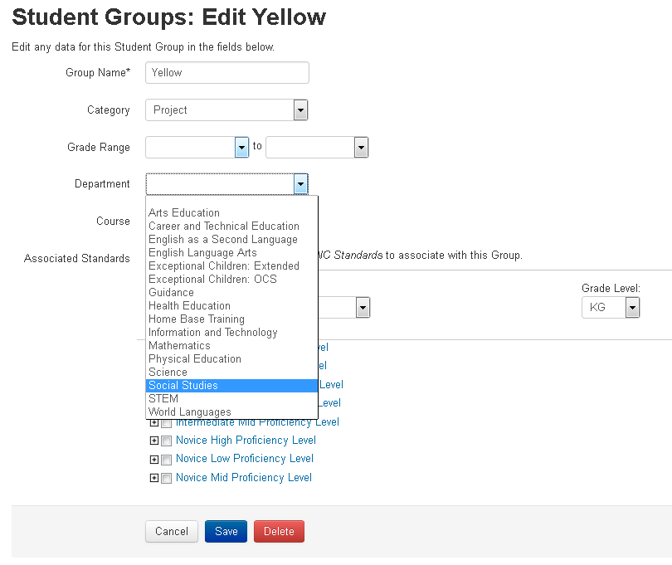
Edit Student Groups
If you need to apply standards to a group, select Edit next to Student Group Details .

Slide 29
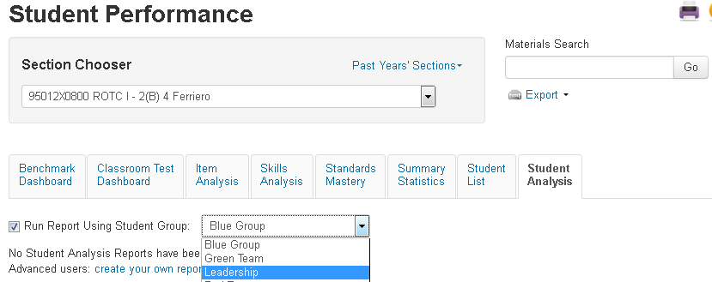
Building an Analysis Spreadsheet with a Student Group
Use a student group as a filter for any analysis spreadsheet. Either build the analysis spreadsheet yourself or use one that is already available to you.
From to the Classrooms menu, click Student Performance
On the Student Performance page, click the Student Analysis tab
3. Check Run Report Using Student Group and from the menu, select your student group
4. To the right of the Student Group menu, click Advanced: create your own report\
5. Select columns to define data in the spreadsheet: first, select the category of data, then select related filters to further define the data
6. When you finish defining each column, click Add Column
7. Repeat the process of adding columns (up to 25) until all data is added to the spreadsheet
8. When you finish defining columns, click Go to Spreadsheet
9. Click any column header to sort

Slide 30
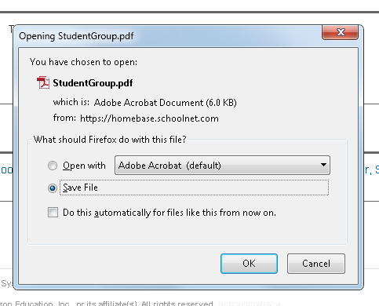
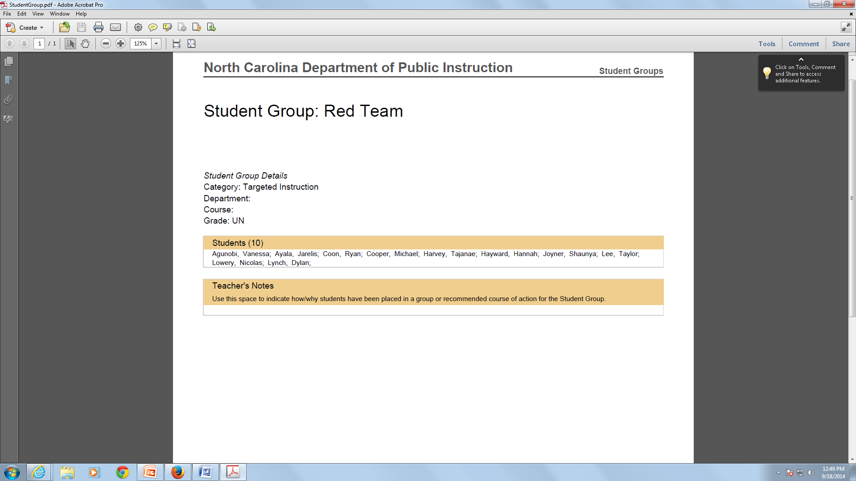
Print Student Groups

Slide 31
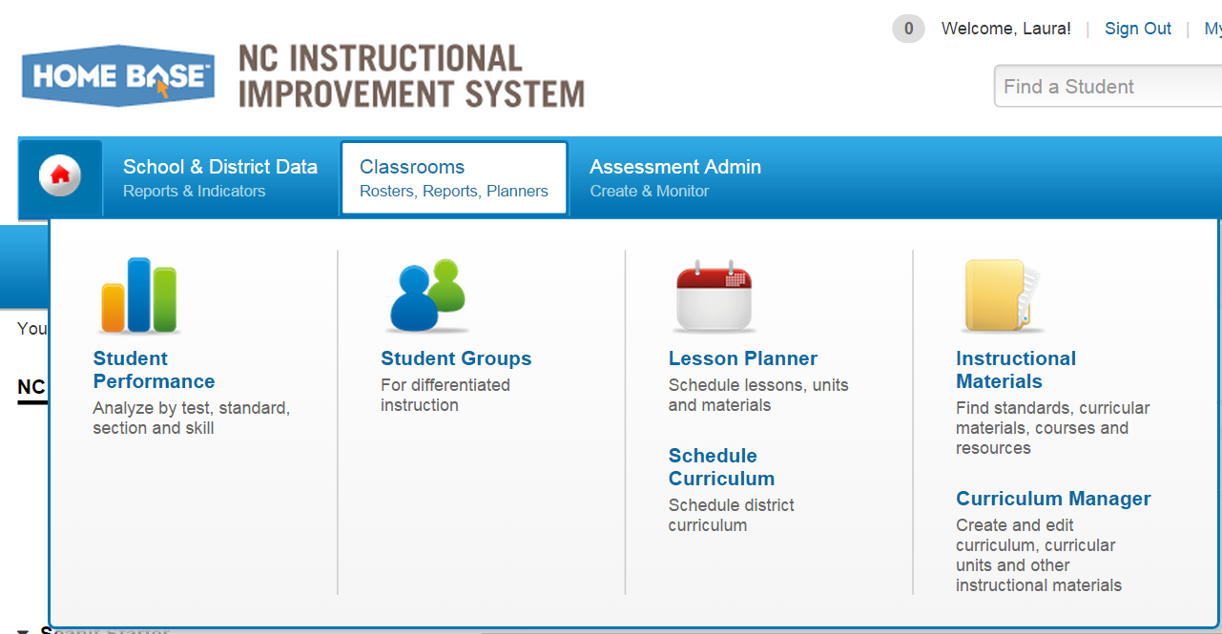
Navigate toLesson Planner
From the SchoolNet homepage put your cursor over Classrooms on the navigation bar and click Lesson Planner

Slide 32
Lesson Planner Calendar

Slide 33
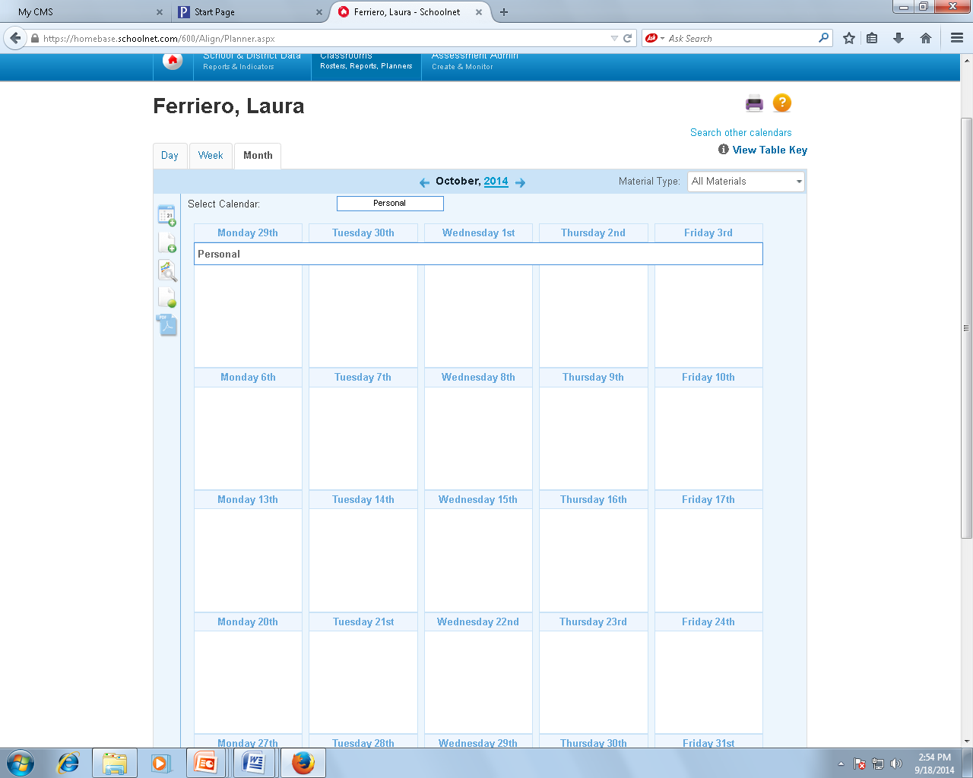
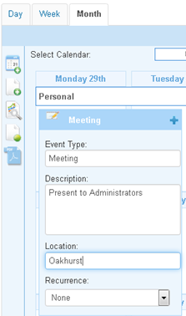
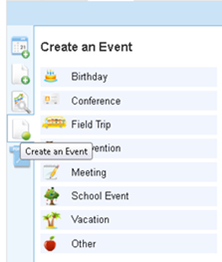
Lesson Planner Calendar
Users can use Lesson Planner to schedule events and place them on the calendar
Use tabs to change calendar view and use arrows to change date

Slide 34
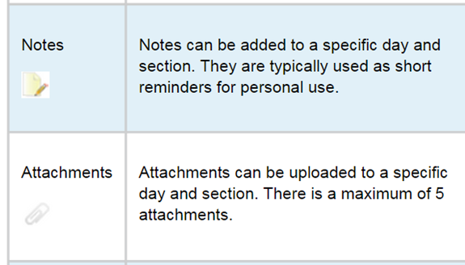
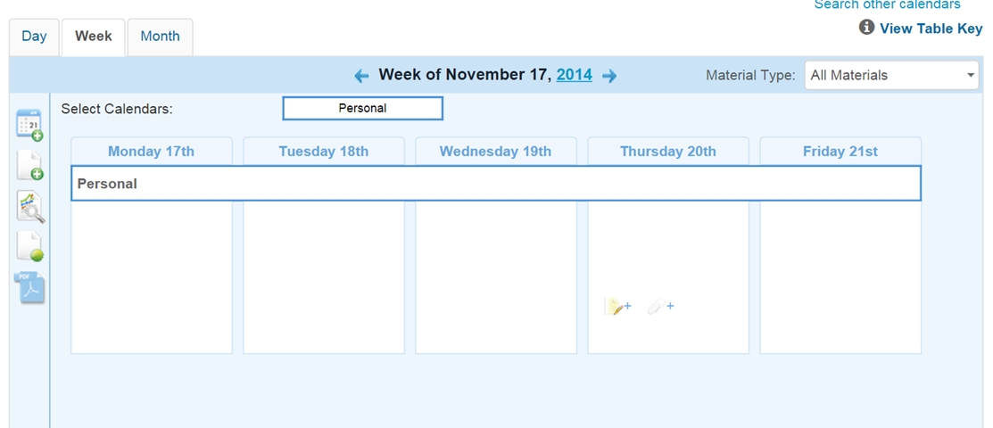
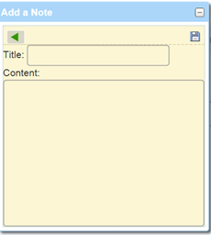
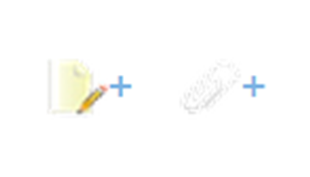

Lesson Planner Calendar

Slide 35
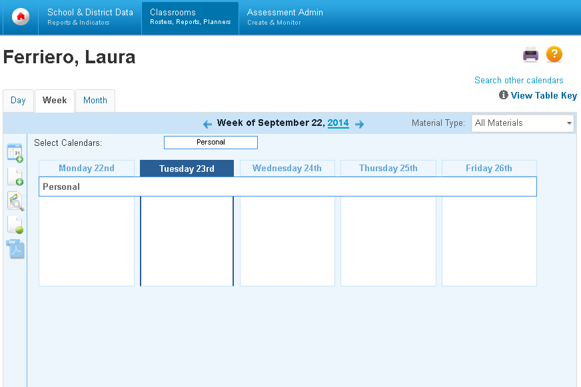
Administrators: Viewing Teachers Calendars
Administrators can view teacher calendars under Lesson Planner Calendar select Search Other Calendars

Slide 36
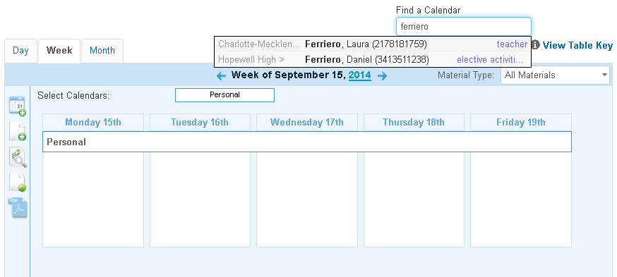
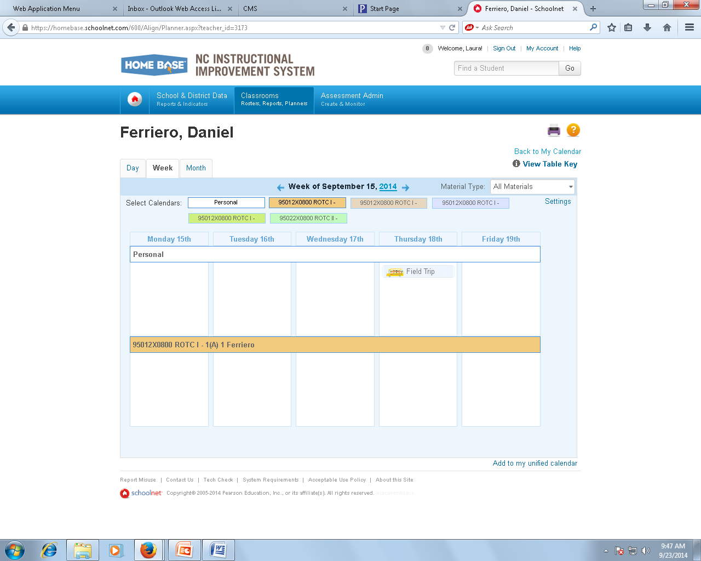
Administrators: Viewing Teachers Calendars
Under Find a Calendar, type in the last name of teacher or staff member. A drop box will appear. Choose the teacher/staff member. The calendar for that employee will appear.

Slide 37
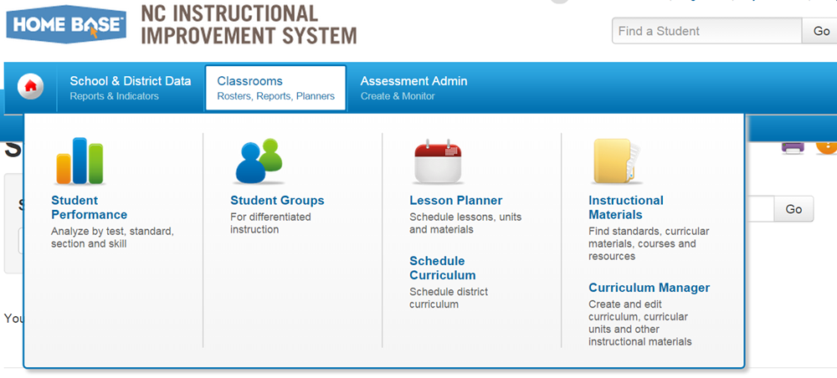
Instructional Materials
From the SchoolNet homepage, put cursor over Classrooms and select Instructional Materials

Slide 38
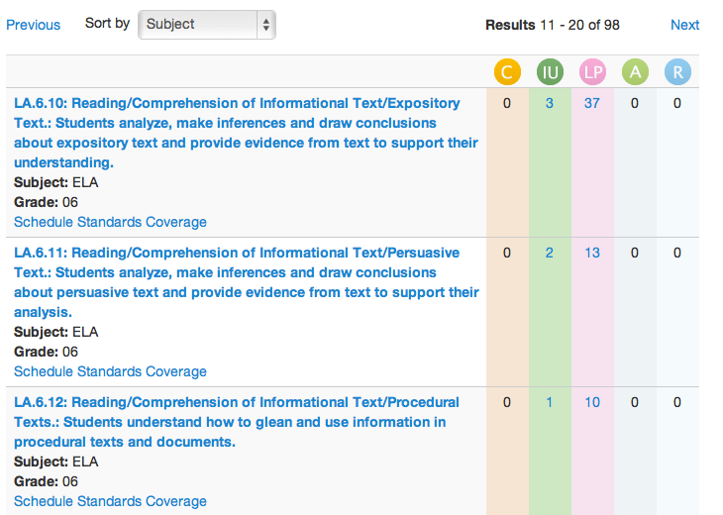
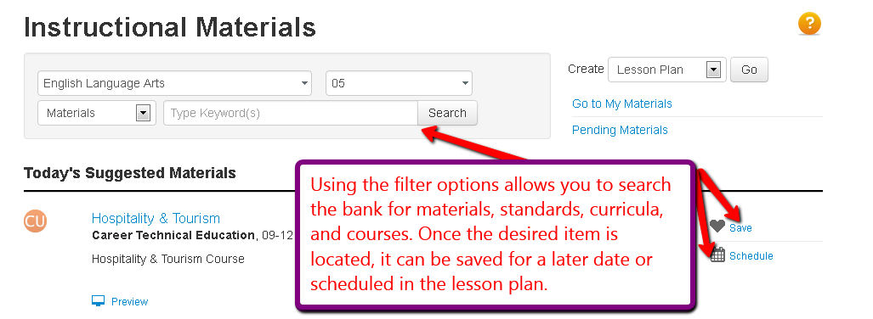
Instructional Materials
The Instructional Materials section offers a bank of resources for teachers. This bank includes standard information, materials, as well as the ability to create new lessons.
Notes:
Talking points:
Users can look specifically for materials and schedule or save them

Slide 39
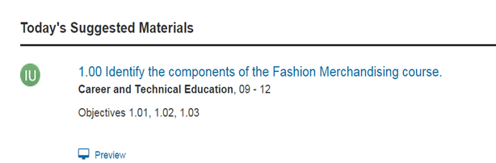
Instructional Materials

Slide 40
Curriculum Manager

Slide 41
Classroom Conclusion
Curriculum Manager
This concludes the Classroom Section Overview.

Slide 42
SchoolNet – School & District Data

Slide 43
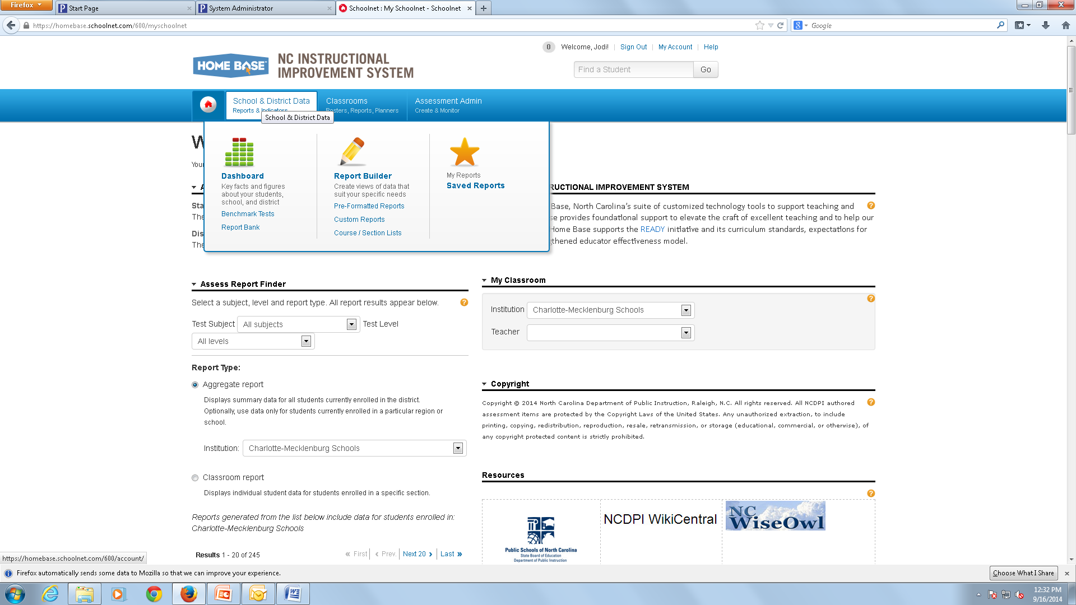
Opening the Dashboard
On the SchoolNet homepage, place your cursor over the tab School & District Data. A drop down box will appear, click on Dashboard.
.

Slide 44
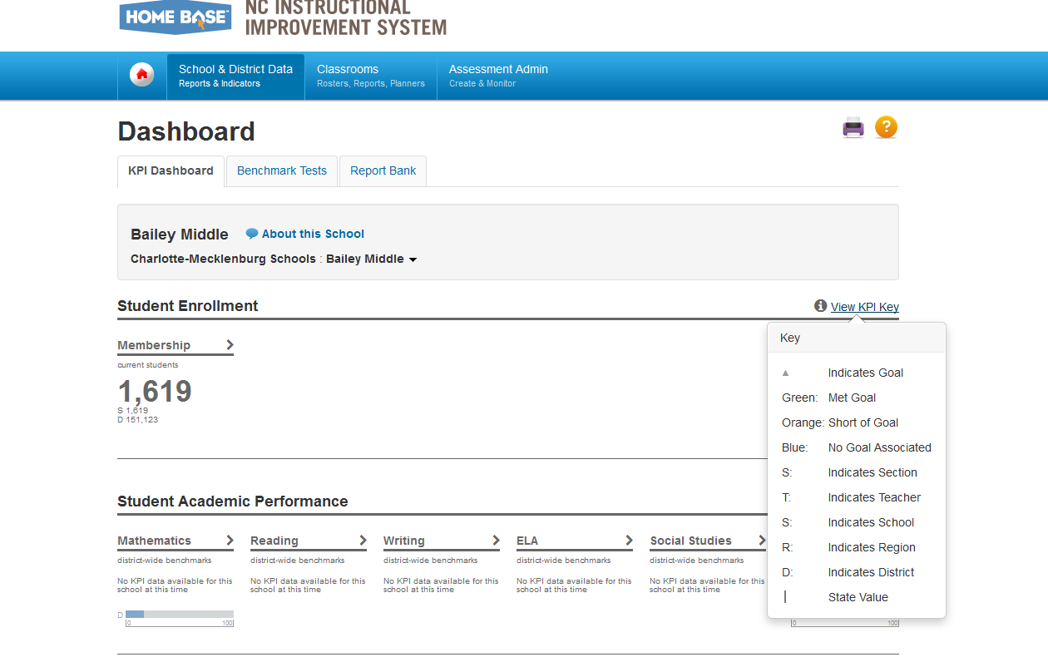

KPI Dashboard Tab
Looking at the Dashboard screen you will notice 3 tabs KPI Dashboard, Benchmark Tests and Report Bank. KPI is the abbreviation for “Key Performance Indicators”.
Click on “View KPI Key” link and a drop box will appear giving you valuable information about the symbols, colors and abbreviations used throughout your Dashboard.
The membership section shows your district & school’s total enrollment. By clicking Membership, you will be able to view detailed demographic information.

Slide 45



KPI Dashboard Tab (Bottom)
Across the bottom of the screen you will notice a list of subjects. Click on a subject for detailed information about your district and school’s performance in that particular subject. By placing your cursor over the Read KPI Description heading a drop box will appear giving you valuable information about the Key Performance Indicator and how it was calculated.
Click on subject for detailed district and school information.

Slide 46


Benchmark Test Tab
Click on the Benchmark Tests tab. Tests are sorted by Test Date. If you click the show filter button, the filter box will appear to help you narrow the search and find the test you are looking for more quickly. Click on the Test Name to see administration details, results and how your school compares with the district.

Slide 47


Report Bank Tab
The Report Bank tab displays reports created and made available by report managers for your use. Click “Run Report” for the results you would like to see. Note-If the button is labeled “Build Report” (instead of “Run Report”), you will choose a student set, or select columns to combine with a student set.

Slide 48

Pre-Formatted Reports
You have the ability to ”Save Report”, “Create a PDF File” or “Export to Excel” by clicking on the corresponding hyperlink. Remember anything in blue is a hyperlink and by clicking on it you will have access to more details and results. Also the question mark, inside an orange circle on each page, links you to a help menu for your convenience.

Slide 49

Report Builder
Please go back up and put your cursor over the “School & District Data” tab. On the drop down that appears let’s click on “Report Builder”. On the next screen you will have the following options to help you build the report you want; Building a Pre-Formatted Report, Build a Custom Report, Course/Section Lists and Define Student Set.

Slide 50




Report Builder Screens
Here is a glance at what each of those sections looks like when you click on their individual link. As you can see there are a lot of great options for building and creating reports, lists and sets.

Slide 51

Saved Reports
Once more go back up to the “School & District Tab”, click on the Saved Reports drop down. This is where you will be able to find, filter and search the tests you previously saved.

Slide 52
Conclusion
This concludes the SchoolNet - School & District Data Overview

Slide 53
Assessment Administration

Slide 54

Assessment Admin
From the SchoolNet home page, select Assessment Admin icon. Select Dashboard

Slide 55

Assessment Dashboard
The Assessment Dashboard is available for administrators and teachers to quickly view and manage assessments that have been created for their sections or school district.
My Tests displays a list of all tests that have created, with the most recent modified tests presented first.
Recommended Tests appears to school-level administrators only. This shows a list of tests that the district has recommended to schools. School administrators may assign these tests directly to teachers by clicking the Assignment Status and accepting or editing the course-based Quick Assignment.
Upcoming Test Windows are used by districts to plan and organize upcoming benchmark administrations by linking a specific test to a test window. Test windows are available in the unified calendar and can be viewed district-wide.
In Progress Tests are tests that have been created and scheduled and which the start date is either today or earlier. Upon test completion, student scores are sent to the Gradebook so that they may be included in students’ final grades.
Scheduled Tests are tests that are ready for administration and that have a start date after today’s date.

Slide 56

Assessment Admin Options
Under the Assessments Administration tab from Schoolnet, there are additional
features that Schoolnet offers administrators.
These components will be performed during the assessment portion

Slide 57

Finding a Test
Located under Assessment Administration is find option to Find a Test
You don’t have to create and schedule a test all at once. To locate tests of all stages, use the filters available in Find a Test.

Slide 58

Click the test name to access the Test Detail screen.

Slide 59



Find a Test
This will open the window and display the test that you selected.
Show the current status of a test

Slide 60

Find an Item, Passage, or Rubric
Item Central contains any items that you create and those that have been provided for your use. Once items are created/made available, you can search for them in order to edit, review statistics or build a test.

Slide 61


Find an Item, Passage, or Rubric
  To locate an item, go under Assessment Administration, Find an Item, Passage, or Rubric.
  Enter a keyword and click Search. Note that only keywords are searchable
  For more search options, use Advanced Search.
Select a tab for the Items, Passages, or Rubrics

Slide 62
Assessment Admin
This concludes the Assessment Admin overview.

