Slide 1
SCHOOLNET SCANIT TRAINING
Notes:
The purpose of this training is to provide details on how to use the ScanIt software to scan paper and pencil results into the Schoolnet.

Slide 2
Agenda
What is ScanIt?
  What are the technical requirements?
  How do I download and launch?
Printing Tests and Answer Sheets
Review of the process for using ScanIt

Slide 3
What is ScanIt?
ScanIt is software used to connect your scanner to the assessment tools in the Schoolnet component of Home Base
Allows for paper and pencil administration of classroom and benchmark assessments
Allows for scanned results to be included with other assessment data in the data and reporting tools

Slide 4
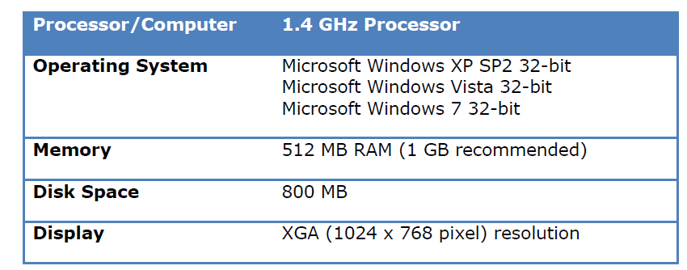
Technical Requirements
Please note that 64 bit may work but it is not supported and has not been tested. At this time there is no download for Mac OS.
Notes:
These are the technical requirements based on what has been formally tested and is known to work. Please note that 64 bit is not supported (it might work, but it has not been tested and it is not supported). Please test your device and scanner to ensure that ScanIt will work for you. At this time there is no download for a for a Mac operating system.
19465 – is the form that worked for an LEA so far (it is not on the supported list, but we have the form definition loaded so that it will work)

Slide 5
Scanner Check List
Confirm that your hardware, scanner, and OMR (bubble sheet) forms (if being used) meet Schoolnet specifications: https://powersource.pearsonschoolsystems.com/d/68725
If you are using a Schoolnet supported scanner, confirm that you have installed the Pearson Runtime Support download from the Schoolnet Support downloads site http://support.schoolnet.com/releases/
    The log in credentials for the Schoolnet Support download are:
    User Name: support
    Password: iloveschoolnet
Notes:
You will find this same information in the NC Scan It Guide on the website at http://www.ncpublicschools.org/docs/homebase/training/materials/schoolnet/classroom-benchmark/20131017-nc-scanit-guide.pdf

Slide 6
Plain Paper Scanners
For plain-paper scanners, confirm that the TWAIN driver has been installed. You may also want to consult this documentation for more information on how to prepare for scanning: https://powersource.pearsonschoolsystems.com/article/68537
Note: Twain driver is an application programming interface that communicates between software and digital imaging devices, such as scanners. If you are going to buy a scanner, buy a plain paper scanner that is TWAIN compliant (cheaper to buy and cheaper to support).
Notes:
You will find this same information in the NC Scan It Guide on the website at http://www.ncpublicschools.org/docs/homebase/training/materials/schoolnet/classroom-benchmark/20131017-nc-scanit-guide.pdf
ScanIt will work with any TWAIN compliant scanner, but please test your scanner with ScanIt to ensure that it works and that you are able to scan.

Slide 7
Resources
Schoolnet Technical Specifications - https://powersource.pearsonschoolsystems.com/article/68725
Common ScanIt Errors - https://powersource.pearsonschoolsystems.com/article/68972?from=search
Note: For the link on this page, you will need a user name and password for accessing PowerSource.
Notes:
Very Important – If you are using an OpScan scanner with forms, you have to use the correct forms that are also compatible with ScanIt. Please reference the tech specs to get the exact forms that are needed for using the scanner.
The common ScanIt Errors document is very helpful and should be referenced if you run into problems using ScanIt.
If you are going to buy a scanner, buy a plain paper scanner that is TWAIN compliant (cheaper to buy and cheaper to support).

Slide 8
Downloading ScanIt
Before you can begin using ScanIt, you will need to download the application onto your computer (or to the computer that is connected to a scanner)
ScanIt can be downloaded from the homepage of Schoolnet.
Notes:
ScanIt is available for download from your my Schoolnet homepage (the home screen that you come to when you click on Schoolnet). The yellow icon has a download for windows option. After download, the same icon is used to launch ScanIt.

Slide 9
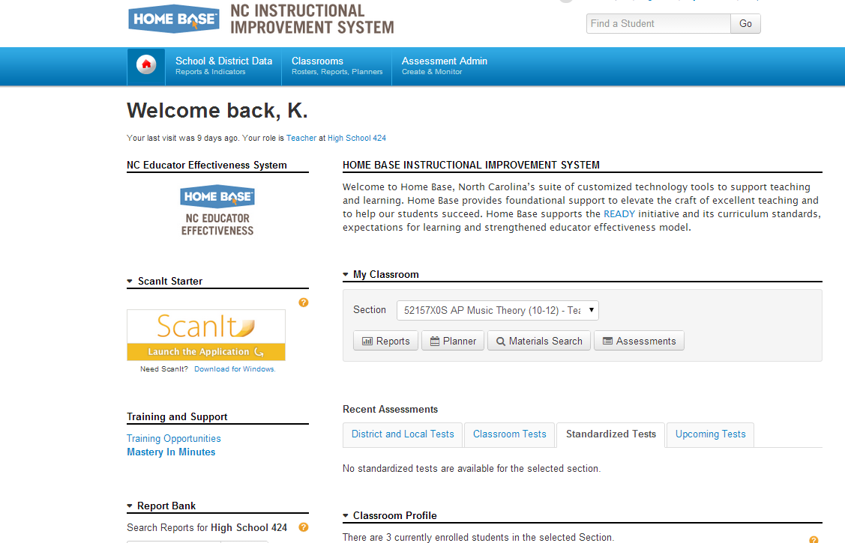
Downloading ScanIt (continued)
Notes:
If it has not been downloaded you will click Download for Windows to install the program.

Slide 10

Downloading ScanIt (continued)
Once the download is complete, you will have a ScanIt icon on your desktop (red school house)
  DO NOT use the ScanIt icon from your desktop as a shortcut to launch ScanIt.
  You should always launch ScanIt by logging into Home Base, clicking on Schoolnet, and then click “Launch the Application” from the ScanIt icon on your home page

Slide 11
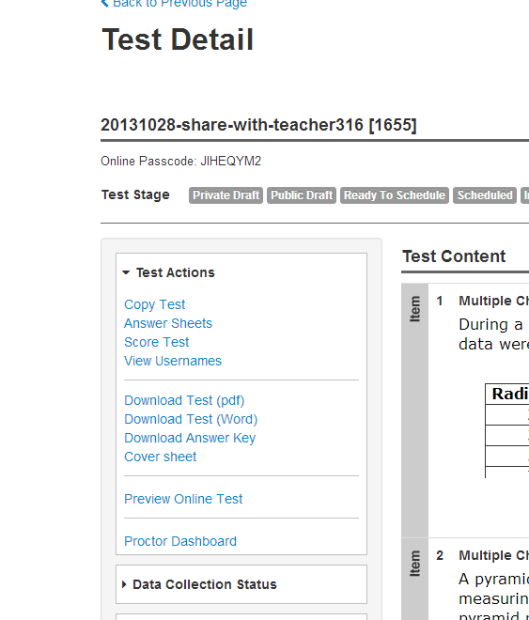
Download Tests
On the Test Detail screen, you can Download the Test (in PDF or Word). You can then print the test as needed.
Notes:
The next few slides are just reminders for how to download and print your tests and how to generate and print answer sheets (for plain paper scanning)

Slide 12
Printed Test
Notes:
This is just a screenshot and an example of what a printed test would look like. I downloaded the particular test we see on the screen as a PDF. You can see questions and answers and it puts multiple items per page.

Slide 13
Generate Answer Sheets
From the Test Detail screen, click on Answer Sheets.

Slide 14
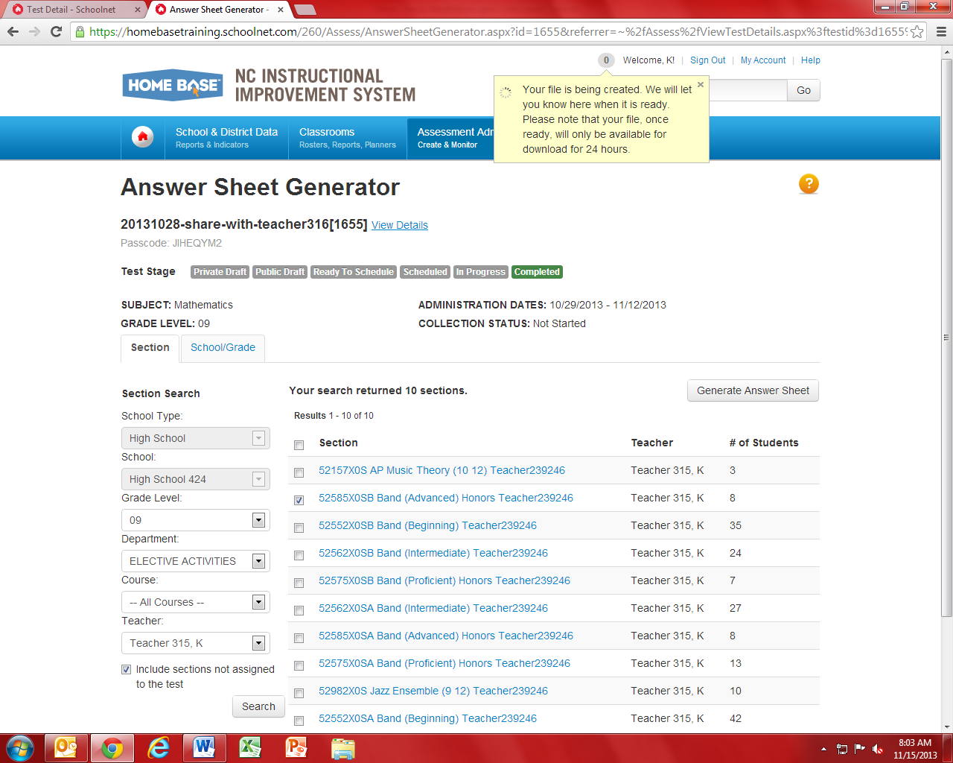
Generating Answer Sheets
Choose the section (s) and then click “Generate Answer Sheets.” You will get a message box letting you know your file is being created.
Notes:
You can print answer sheets for all the classes/sections taking this assessment, or just one class/section at a time. Click on Generate Answer Sheets.

Slide 15
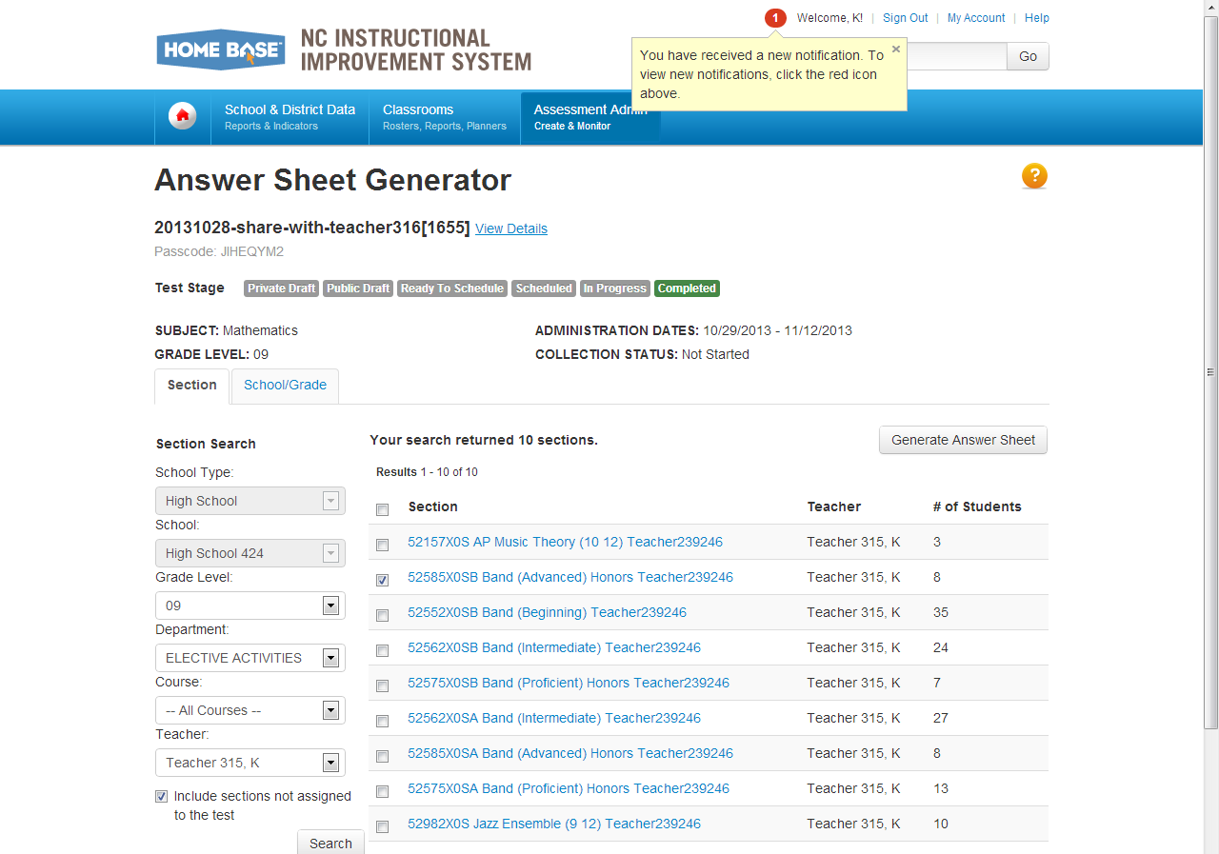
Generating Answer Sheets
When your file is created, you will get a notification in the upper right hand corner.
Notes:
When you click the box, Generate Answer Sheet, you’ll see a little pop up in the top in your announcements section, where it normally would usually say “Welcome” and your name.
The screen shot shows what that box would look like. It lets you know the file is being created and the system will let you know when it’s ready.
Once your file is ready it will only be available for download within 24 hours.

Slide 16
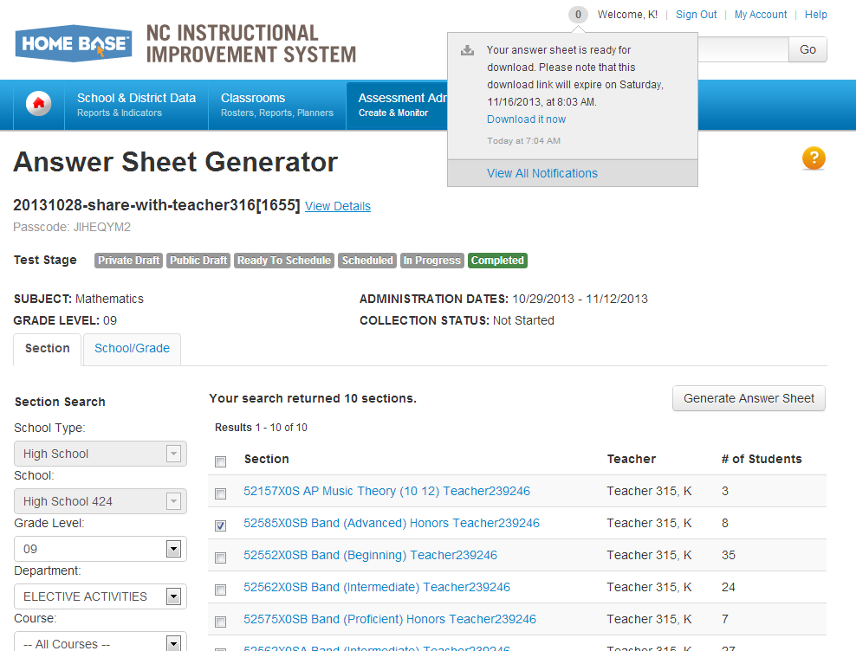
Download and Print Answer Sheets
Click on the notification and you will see the message “Your answer sheet is ready for download.” Now you can download and print your answer sheets.

Slide 17
Plain Paper Printing
Most printers that can accurately print a Schoolnet answer sheet as rendered in the generated PDF are supported. Printers must render the page faithfully without a noticeable variation in contrast within a page, as is typical when a page is printed from a printer low on ink/toner. Legibility of the bar code in the upper right of the answer sheet is critical for successful scanning to ScanIt; low-quality inkjet printers or thicker papers may diminish the quality of the printed barcode.
Notes:
When you print your answer sheets, make sure you follow the printer settings for plain paper to ensure that your printed answer sheets will be compatible with ScanIt. You can find this information in the NC ScanIt Guide on the website at http://www.ncpublicschools.org/docs/homebase/training/materials/schoolnet/classroom-benchmark/20131017-nc-scanit-guide.pdf.
Make sure the answer sheets are only printed single sided. It is possible that the scanner could pick up ink from the back of the page that could result in an error if there is printing on both sides.

Slide 18
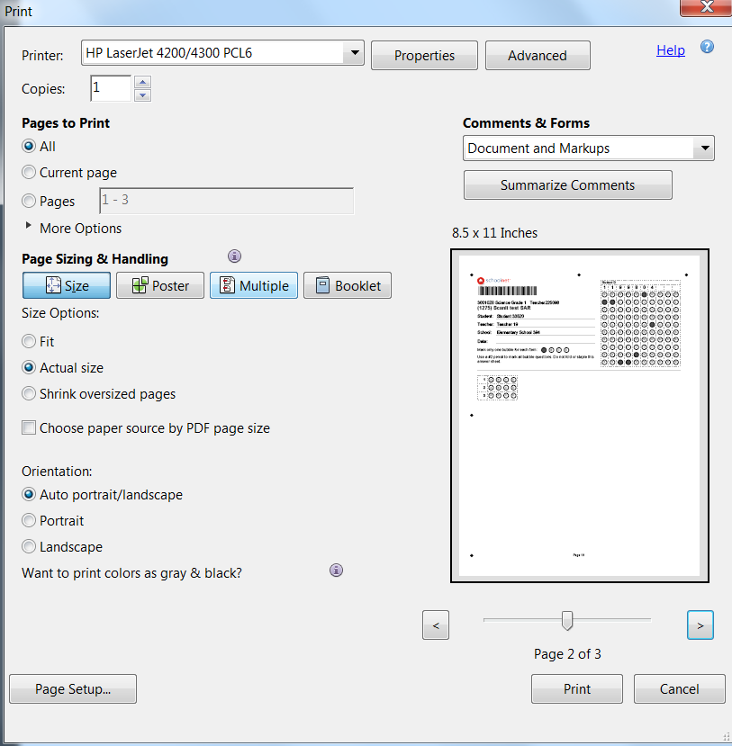
Plain Paper Printer Settings
The following printer settings are suggested:
  For Size Options, select Actual Size
  For Orientation, select Auto Portrait/Landscape

Slide 19
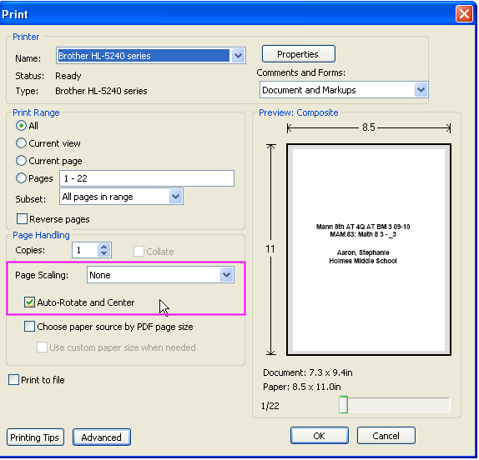
Plain Paper Printer Settings
If you have a different version of Adobe Acrobat Reader, your print options should be:
  For Page Scaling, select None
  And the check the box for Auto-Rotate and Center
Notes:
This is just another example of printer settings (depending on the version of Adobe Acrobat Reader that you are using).

Slide 20
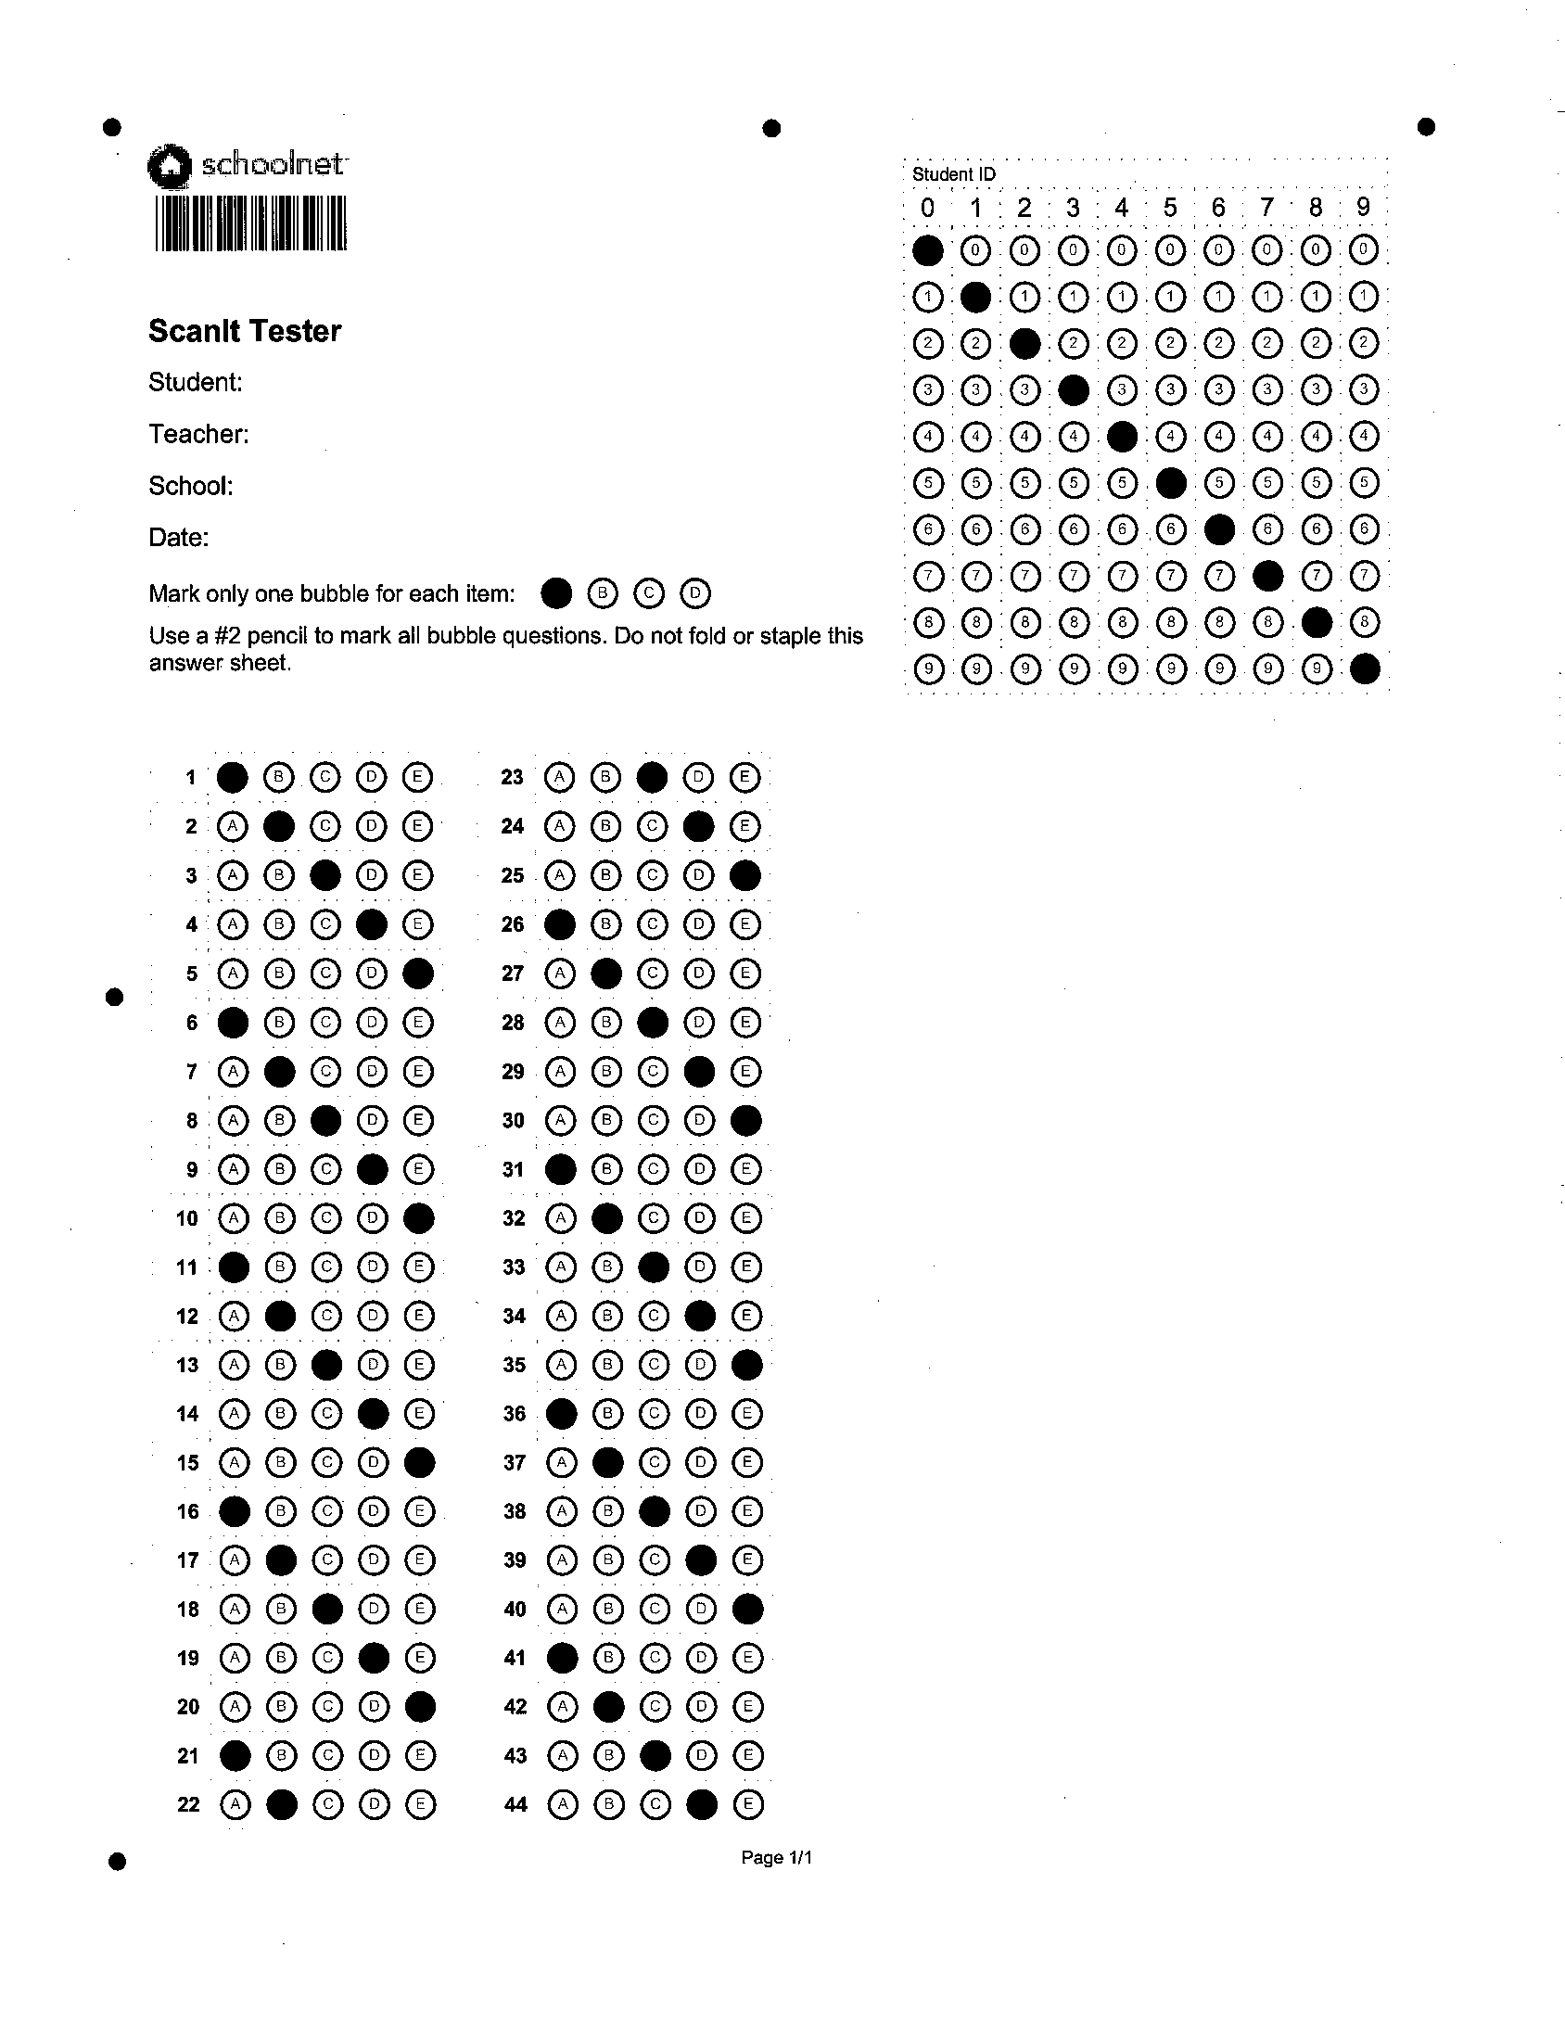
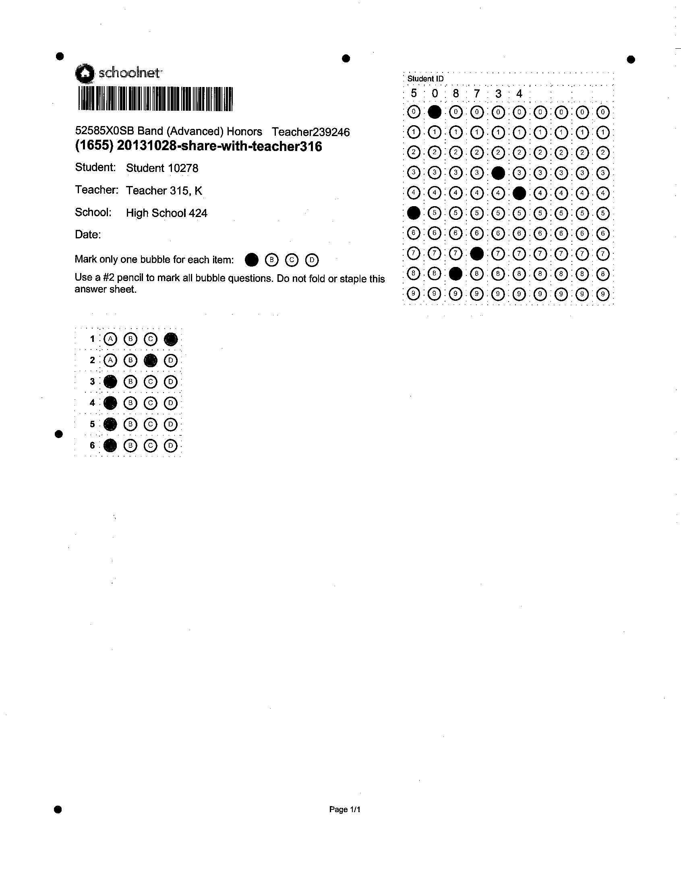
Sample Printed Answer Sheets
Notes:
If you are using a scanner that has the forms (bubble sheets). You don’t need to generate your own bubbles sheets. The students can use the ones you have. If you’re using the plain paper scanner, you’ll need your own bubble sheets. And what’s great about this is you can just print them on regular old printer paper, it’s got the bubbles on it, exactly the number that the students need, and you’re ready to go.

Slide 21
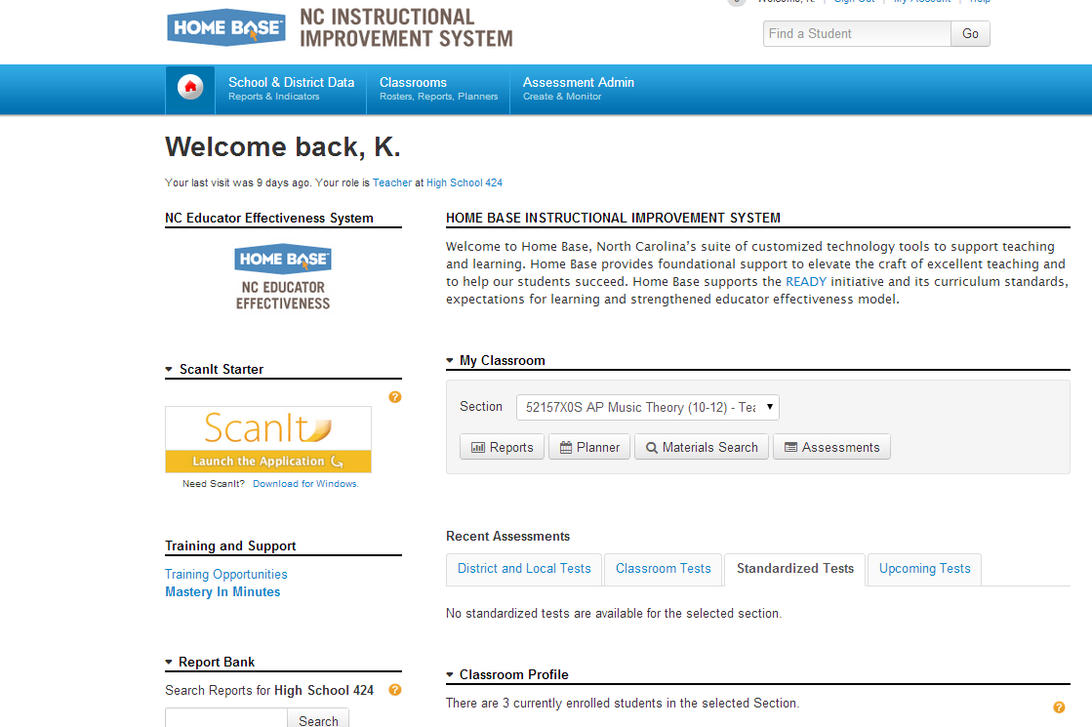
Ready to Scan
Click “Launch the Application” to open ScanIt.
Notes:
Students have taken the test>Answer sheets ready>Everything printed>Ready to scan
Log back in to Schoolnet from Homebase
Click Launch Application

Slide 22
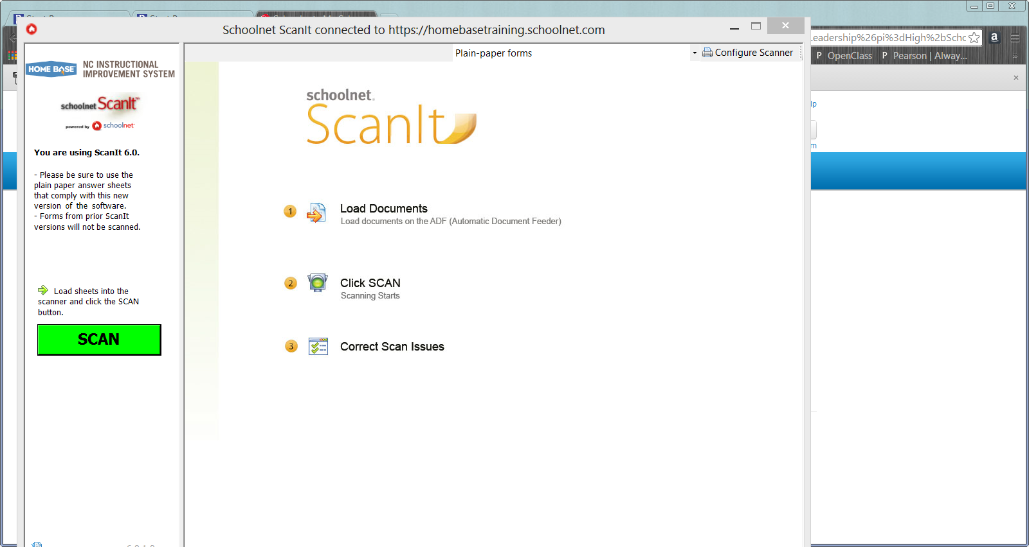
Using ScanIt
At the top right you will click the dropdown and choose the correct form.(plain paper or the form name-Form 19465 has been tested )
Make sure you are connected to your scanner and your scan sheets are loaded in the scanner and ready, then click on the green SCAN button.
1
1
2
Notes:
From this screen you can see that there are 3 main steps to the scanning process with ScanIt:
1 - Load Documents -Place the answer sheets in a firmly lined stack, all facing the same direction. You may want to tap the stack against a table or desk to make sure all the pages line up as closely as possible. Then, place the whole stack into the scanner’s feeder in the manner as indicated on your machine, such as upside down or face down. Make sure to use your scanner’s paper guides to make sure the forms are feeding straight into the scanner. NOTE: If your scan results in blank pages, you will want to check that you have put the pages into the scanner in the correct manner. This is a common mistake.
2 - Click SCAN - After you load the documents into your scanner, click SCAN on the left side of the screen. The scanning counter pane on the left side of the screen will indicate the progress of the scan, including the total number of sheets scanned, processed, and uploaded, as well as the sheets that require review or manual entry.
3 - Correct Scan Issues -Any answer sheets or answer sheet responses that the scanner cannot fully interpret display in a list under the Review Recommended and Requires Manual Entry tabs. The screen shot below is a scan issue that requires manual entry. If sheets do not have any issues, they will not be listed in the right hand portion of the screen with the sheets that need to be reviewed or that require manual entry.

Slide 23
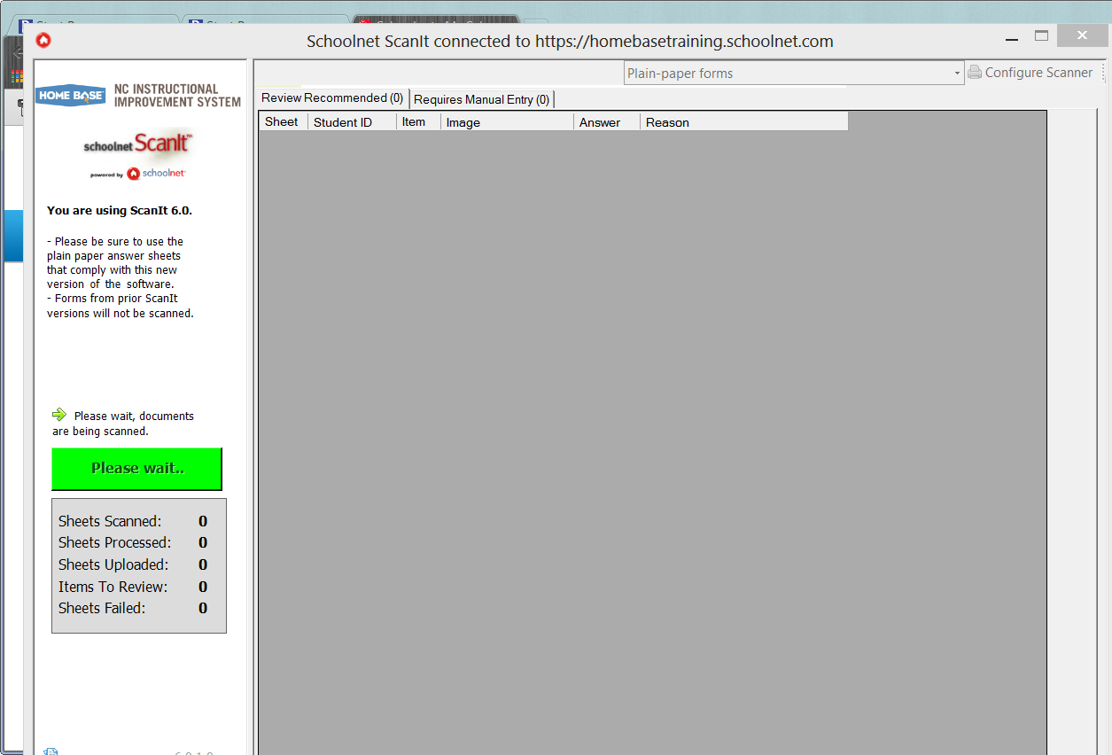
Documents are Being Scanned
Notes:
Please Wait – computer is connecting to the scanner and documents are being scanned. You will start to see “sheets scanned” number change as your sheets are being scanned.

Slide 24
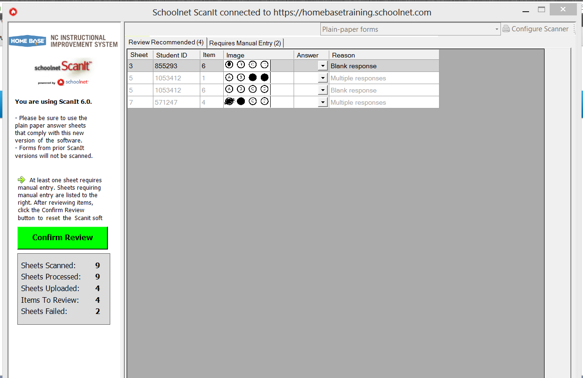
Scanning Complete – Errors to Review
Now review errors (if any) on the two tabs:
Review Recommended
OR
Requires Manual Entry
Notes:
When your scan is complete, you will have the option to review and confirm errors. If something in an answer sheet does not scan correctly, you may see that some of your sheets failed. You can check these on the Requires Manual Entry Tab (to see the student number and sheet number that failed) and rescan to confirm that the results are in.
Sheets Scanned – this includes the total sheets scanned, even a cover sheet without any barcode or marks
Sheets Processed – sheets that the scanner was able to process
Sheets Uploaded – results had no errors and were uploaded to Schoolnet
Items to Review – Details the items that need review (these items are also displayed in the gray box on the screen)
Sheets Failed – You can find more about these sheets on the Requires Manual Entry Tab (in the center section) – you can correct these sheets and re-scan or you can manually enter the results if you have them readily available

Slide 25

Confirm Review
When you have made necessary corrections, click Confirmed Review.
Notes:
On the “review recommended” tab, you can see the items for review and make corrections. On this screen you can see that on sheet 3, it appear that the student tried to bubble in answer choice A, so you can go ahead and select A as the answer and it will over-ride the blank response that was indicated by the initial scan (once you confirm review)
Sheet 5 appears to have two items that will need further investigation (one with 2 answers and one blank, you can check with the student and confirm or have it corrected on the answer sheet and re-scan)
And on sheet 7 there is an item that appears to have 2 answer choices selected, but reviewing the original you can see that A was erased and B was the answer selected. So as with the earlier sheet, you can select the correct answer so that it is loaded in with the other results.

Slide 26
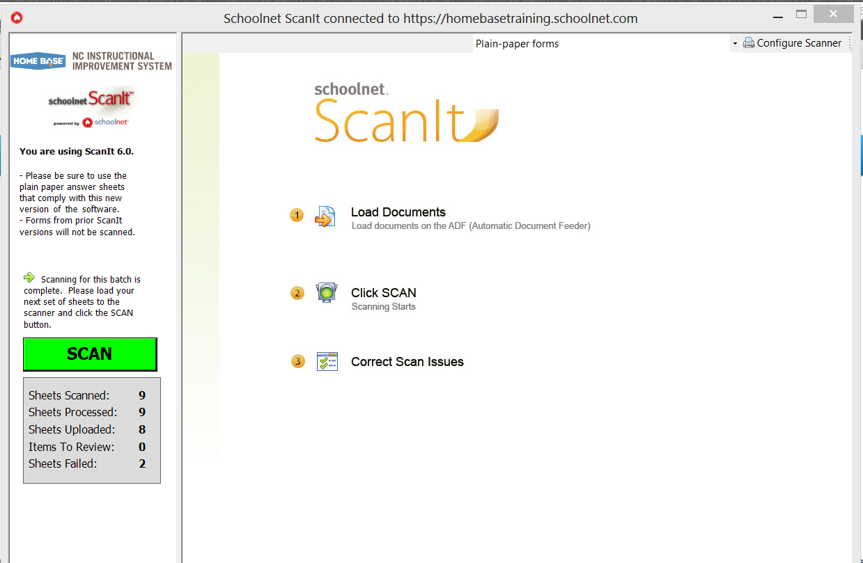
Scan Complete
Notes:
Once you Confirm Review, you will go back to the main ScanIt page and you can see the final results in the gray box below the green SCAN button. In this shot you can see that I still had 2 sheets that failed. These will need to be rescanned, or the results can be manually entered into Schoolnet (the results for these tests will be laoded as “no response” into Schoolnet until you re-scan or enter the responses).
(Maybe get a new screen shot that does not have errors? Maybe)

Slide 27
Guide for using ScanIt
http://www.ncpublicschools.org/docs/homebase/training/materials/schoolnet/classroom-benchmark/20131017-nc-scanit-guide.pdf

Slide 28
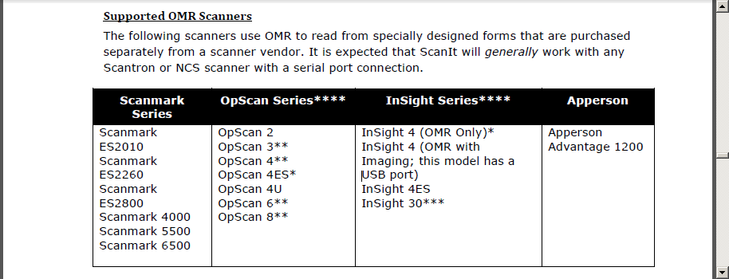
Supported OMR Scanners
Notes:
*These models will only work with a USB emulated serial port. Please reference the document “Configuring the USB Emulated Serial Port for NCS Pearson Scanners” on the Pearson Powersource site for directions.
**These scanners only have a serial port. To connect these scanners to a computer that does not have a serial port, please use the USB-serial converter Keyspan Adapter (part number is USA-19HS). This is the only converter that has been tested and approved for use with these scanner models.
***To use this model with ScanIt as an OMR scanner, port name “L_port_twain” must be selected within ScanIt’s Scanner Configuration.
**** Need to install the Pearson Runtime Module from the Schoolnet Support Downloads Site in order for OMR forms to be recognized in ScanIt.

Slide 29
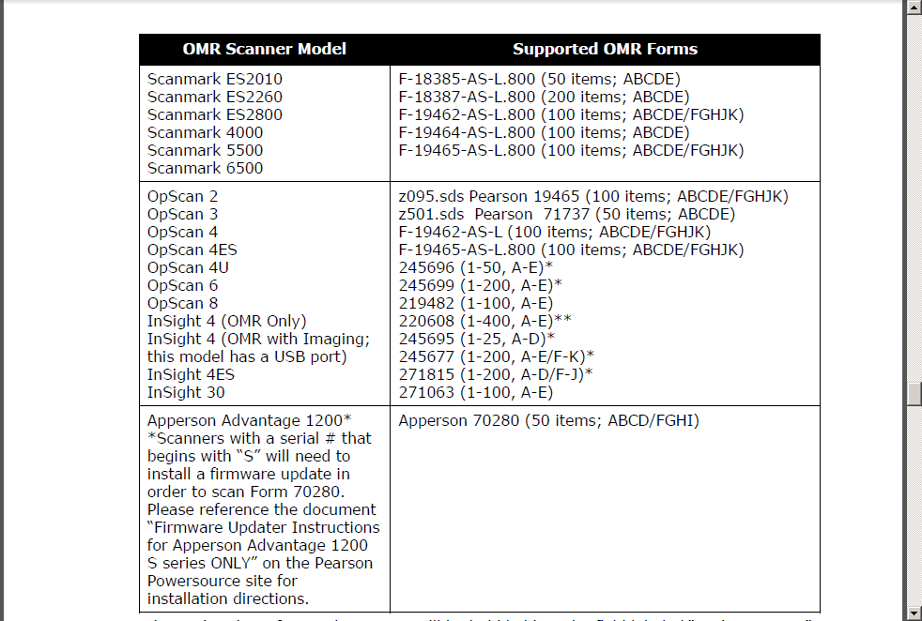
Supported OMR Forms
Notes:
*When using these forms, the Test ID will be bubbled into the field labeled “Assignment ID”. **The Schoolnet application only supports up to 200 items on a test.

