Slide 1
Introduction To
August 2015
By Kim Williamson (kim.williamson@cms.k12.nc.us)

Slide 2
Agenda
What is PowerSchool?
PowerTeacher Overview
PowerTeacher Gradebook Overview
List of Additional Resources

Slide 3
What is PowerSchool?
•PowerSchool is the fastest-growing, most widely used web-based student information system, supporting 10 million students in all 50 states and over 65 countries.
•PowerSchool enables today's educators to make timely decisions that impact student performance while creating a collaborative environment for parents, teachers and students to work together in preparing 21st century learners for the future.

Slide 4
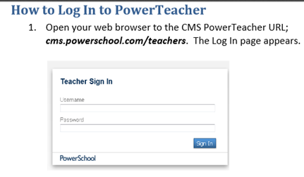
Logging In to PowerTeacher
http://cms.powerschool.com/teachers
Username: 10 digit NC ID Number
Password default: changeme
(PowerTeacher will make you change your password once you login the 1st time).

Slide 5
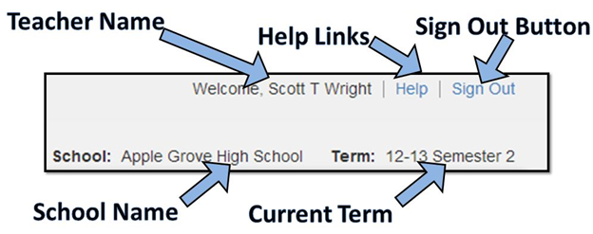
Navigating Your Start Page

Slide 6
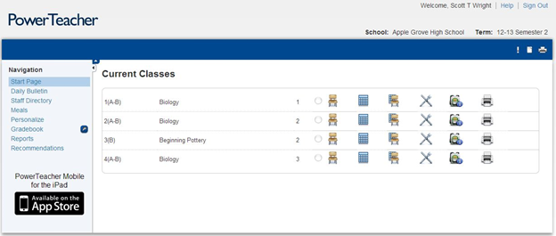
PowerTeacher Start Page
Return to PowerTeacher Start Page
Navigation Toolbar
Multi-Day Attendance
Seating Chart Attendance
Attendance
Lunch Counts
View Student Information
Print Reports

Slide 7
Taking Attendance
An Attendance indicator icon appears next to each class. The color of the dot indicates whether or not you have taken attendance for that class.
Click the chair icon next to the class for which you want to take attendance.
Choose the appropriate attendance code from the Current attendance code drop-down menu.
Click the cell next to each student who is absent or tardy to insert the code you chose from the drop-down menu.
Click Submit
Note: Attendance may also be taken by using the Multi-day and Seating Chart icons

Slide 8
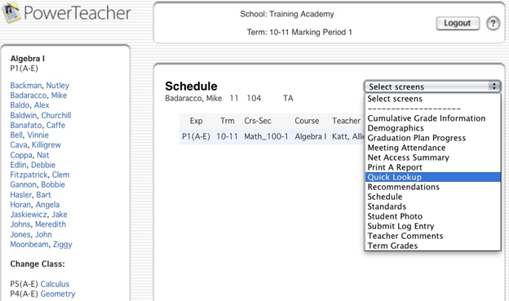
Accessing Student Information
Click the backpack icon next to the class you want to view.
Click the student’s name.
Choose a student page to access from the Select Screens drop-down menu on the left side of your screen.
Select the student screen you want to view.

Slide 9
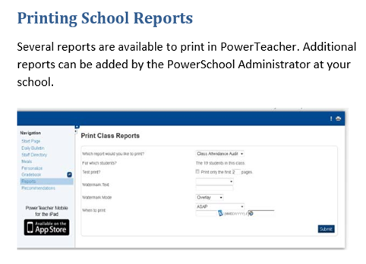
Printing School Reports
Click the printer icon next to the class for which you want to print a report.
Choose the report from the Which report would like to print from the drop-down menu.
Choose the watermark text (optional).
Choose when you want PowerSchool to prepare your report.
Click Submit.

Slide 10
Change Password
Click Personalize.
On the Personalize page, click Change Password.
Enter your old password, then enter verify the new password.
Click Submit.

Slide 11
Power Teacher-Staff Directory
Staff Directory
Teachers access the staff directory through PowerTeacher. The Staff Directory defaults to the list of all staff members, but it can be sorted by staff type. Each staff member’s name, room number, email address, home phone number, and school phone number are shown.
To display filtered lists:
1. Navigate to Start Page >Staff Directory
2. Click All to display the list of all staff members
3. ClickTeachersto display the list of teachers
4. Click Staff to display the list of other staff members, such as office staff and administrators
5. Click Lunch Staff to display the list of lunch staff
6. Click Substitutes to display the list of substitute teach
To email a staff member:
Click the email address link next to the person’s name
To email a group of staff members:
Copy and paste the email addresses found in the Group Email field
at the bottom of the list into your email client

Slide 12
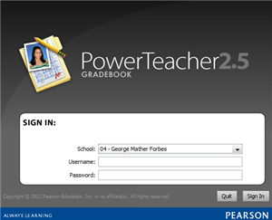
PowerTeacher Gradebook
PowerTeacher Gradebook is the the portion of PowerTeacher that contains a record of grades for all students. Teachers will use this application to enter assignments and grades, which will then be automatically calculated to create progress and report card grades.

Slide 13
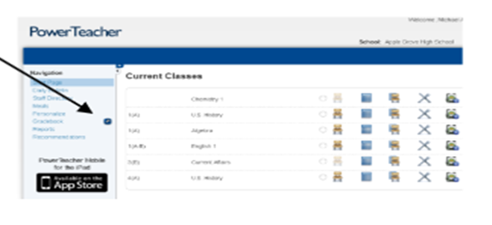
How to Launch Gradebook
On the Start Page, Click “Gradebook” then “launch Gradebook”
Note: As the program launches, users will need to click “Trust”

Slide 14
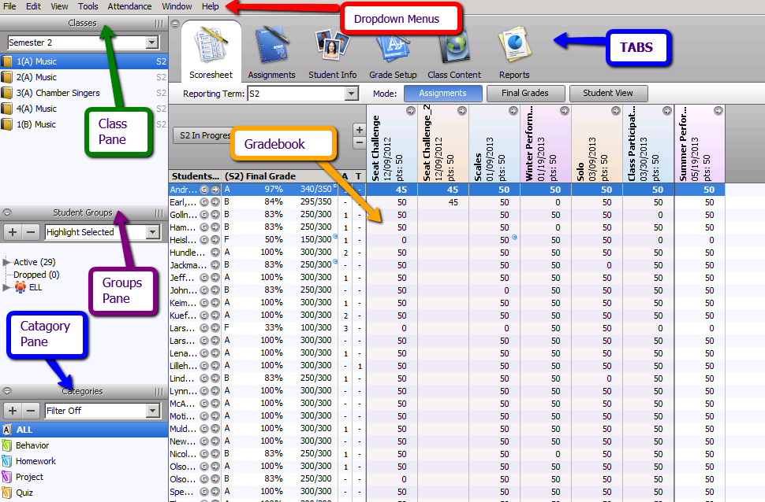
Gradebook Home Screen Tour

Slide 15
Gradebook Tabs
Scoresheet Tab: Used to add assignments and enter grades.
Assignments Tab: Used to create assignments
Student Info: Used to view student information
Grade Setup: Used to setup term, quarter, semester, exam, and year weights
Class Content: Used to view content regarding the class
Report: Used to run various reports (i.e. Student Progress)
Attendance: Used to take attendance from the Gradebook
Notifications: Used to notify you of student information

Slide 16
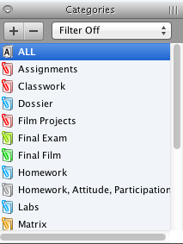
Defining Categories
Gradebook contains 4 pre-defined categories: Homework, Project, Quiz, and Test which will be deleted. (Select and click the minus (-) button in top left corner of the categories window)
The pre-defined categories will be replaced with: informal, formal, mid-term exam, and final exam. (Select the plus (+) button in the top left corner of the categories window)
Note: If you teach English III or IV you must also create a Graduation Project category , and if you teach Spanish I or French I you must also create a Summative Performance Category
The categories that you create will be available to all of the classes you teach.

Slide 17
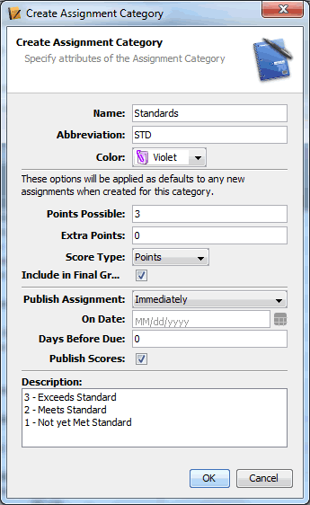
Defining Categories (cont.)
In the category name field type Formal.
In the Abbreviation field type Formal.
Set the default number of points possible to 100.
Choose a color.
Check to include in the Final Grade.
Choose to publish assignments immediately.
Check to publish scores.
Add a description (Optional)
Click OK to save categories you created.
repeat steps 1-9 until you have the following categories: informal, mid-term exam, final exam, and graduation project if needed

Slide 18
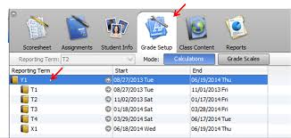
Reporting Term Setup
Calculates the final grade for an individual reporting term and must be setup for each reporting period. This process will need to be completed for each class you teach.

Slide 19
Reporting Term Setup - 18 Week Courses
Please note that this setup DOES NOT apply to English III, English IV, Spanish I, or French I
Quarter 1or Quarter 3 - 37.5
Formal - 60
Informal - 20
Mid-Term - 20
Quarter 2 or Quarter 4- 37.5
Formal -70
Informal - 30
E1 - 25
Final Exam - 100

Slide 20
Reporting Term Setup - 18 Week Courses (English III and IV Only)
Quarter 1 or Quarter 3- 37.5
Formal - 60
Informal - 20
Mid-Term - 20
Quarter 2 or Quarter 4 - 37.5
Formal - 60
Informal - 20
Graduation Project - 20
E1 - 25
Final Exam - 100

Slide 21
Reporting Term Setup - 18 Week Courses (Spanish I and French I Only)
Quarter 1 or Quarter 3 - 37.5
Formal - 60
Informal - 20
Mid-Term - 20
Quarter 2 or Quarter 4- 37.5
Formal - 45
Informal - 30
Summative Performance- 25
E1 - 25
Final Exam - 100

Slide 22
Reporting Term Setup - 36 Week Courses
Please note that this setup DOES NOT apply to English III, English IV, Spanish I, or French I
Semester 1 - 37.5
Quarter 1 - 40
Formal - 70
Informal - 30
Quarter 2 - 40
Formal -70
Informal - 30
X1 - 20
Mid-Term Exam - 100
Semester 2 - 37.5
Quarter 3 - 100
Formal - 70
Informal - 30
Quarter 4 - 100
Formal -70
Informal - 30
E1 - 25
Final Exam - 100

Slide 23
Reporting Term Setup - 36 Week Courses (English III and IV Only)
Semester 1 - 37.5
Quarter 1 - 40
Formal - 70
Informal - 30
Quarter 2 - 40
Formal -70
Informal - 30
X1 - 20
Mid-Term Exam - 100
Semester 2 - 37.5
Quarter 3 - 100
Formal - 70
Informal - 30
Quarter 4 - 100
Formal - 40
Informal - 20
Graduation Project - 40
E1 - 25
Final Exam - 100

Slide 24
Reporting Term Setup - 36 Week Courses (Spanish I and French I only)
Semester 1 - 37.5
Quarter 1 - 40
Formal - 70
Informal - 30
Quarter 2 - 40
Formal -70
Informal - 30
X1 - 20
Mid-Term Exam - 100
Semester 2 - 37.5
Quarter 3 - 100
Formal - 70
Informal - 30
Quarter 4 - 100
Formal - 30
Informal - 20
Summative Performance - 50
E1 - 25
Final Exam - 100

Slide 25
Copying Final Grade Set-Up
Once the Final Grade Set-up has been created for one class, it can be copied to the remaining class you teach.
Steps:
Right Click on F1 folder
Select, “Copy Grade Setup -- Entire Class”
Select the classes that you to want the Final Grade Setup to be copied and click Ok.
If you select a class from a different semester, a dialog entitled “mismatch detected” will appear. When this appears select Q1 to match up with Q3 and select Q2 to match up with Q4 and Vice Versa. Click confir.
When the confirmation dialogue box should appear, then click finished.

Slide 26
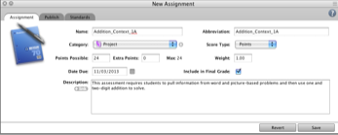
Assignments
Assignments can be added to the Gradebook anytime during the school year, term, or semester. Assignments automatically appear in specific terms based on the term dates. The dates for each term can be viewed on the grade set-up tab.

Slide 27
Creating An Assignment
Select a class from the classes pane. (top left of Gradebook)
Click the Assignments tab. The assignment window appears.
Click the (+) button. The new assignment window appears.
Enter the assignment name.
Select the category you want the assignment to be associated with. (i.e. Formal, Informal, Mid-Term, Final Exam, Graduation Project, or Summative Performance.
Enter possible points.
Enter a Due Date.
Check include in Final Grade.
Enter a description of the assignment (optional).
Choose when to publish the assignment.
CLick Save.

Slide 28
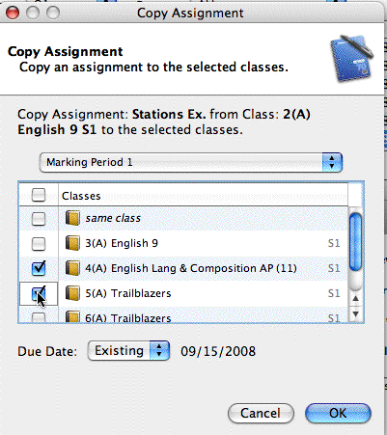
Copying An Assignment
You can copy assignments from one class to another from current or previous term. Copy assignment can be found in the tools menu at the top of the screen.

Slide 29
Entering Scores
Scores can be entered individually or by using the quick Entry Methods.

Slide 30
Entering Scores Individually
From the assignments tab, click in the cell that is the intersection of the row containing the student’s name and the column of the assignment you want to score.
Enter the score and press the enter button to advance to the next student and tab to advance to the next assignment.
When you have finished entered scores, click Save.

Slide 31
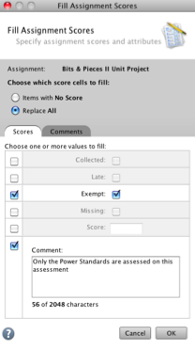
Entering Scores Using Fill-Scores
Select FIll Scores from the Tools Menu while in the Scoresheet or Assigment tabs.
You can fill empty scores if you have not entered grades or choose the replace option to override what you currently have if you desire.
Select from one of the choices, or enter a score and add a comment if desired. Note all of the selected students in the class will receive the score and comment that was just entered.
Click Ok.

Slide 32
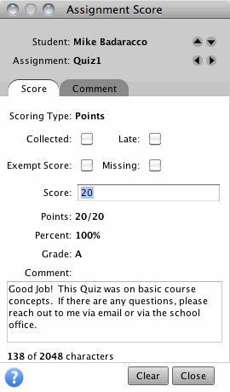
Using the Score Inspector
The Score Inspector provides the ability to add notes to yourself about a student’s performance in class such as, late, exempt, or missing. You can also use the Score Inspector to enter a public comment.

Slide 33
Using the Score Inspector (cont.)
Click the Tools Menu and click Score Inspector.
On the Scoresheet, click in the assignment column in the first empty cell you want to next to the appropriate student you want to score. In the score inspector, you can select: collected, late, exempt, missing, input the score and/or type in a comment.
To add a comment you can type in the field.
Toggle between students by using the down/up arrows or go between assignments.
The clear button clears the score, comment of a check.
Click close when finished . Then click save.

Slide 34
Printing Reports
Use the reports available through the gradebook to provide a paper or electronic copy of student information. Report can be personalized by entering a custom title or including a top note, bottom note, and signature line. There are 8 types of reports available, and they can be represented in three output types: PDF, HTML, or Text Export (CSV).

Slide 35
Types of Reports
Attendance Grid - Use to mark attendance manually. Format to print for specific dates or no dates.
Category Total Report - View a summary of category totals for a student or class. Choose a report a specific term or all terms.
Final Grade and Comment Verification - View final grade information for your students. Select to include all final grades information or specific information, like final grade only.
Individual Student Report - View a summary of class information per student similar to a progress report. Choose what grade information is printed as well as the date range.

Slide 36
Types of Reports (cont.)
Individual Student Report: View of summary of class information per student similar to a progress report. Choose what grade information is printed as well as the date range.
Missing Assignment Report: View a list of students with assignments not scored or missing. Select to print the student number instead of name so the list may be posted.
Student Multi-Section Report - View final grade information for all of a student’s sections, not just your class. Choose specific terms to include.
Student Roster - View student demographic information. Select to include a variety of student information and even format a column to keep track of money collected or permission received.

Slide 37
Additional Resources
CMS PowerSchool Documents: http://my.cms.k12.nc.us/departments/techserv/stuapps/powerschool/Pages/Documents.aspx
PowerSource: https://powersource.pearsonschoolsystems.com/login.action

